Slide 1
Family Medicine Advocacy Summit 2018 Recap
Selim Sheikh, DO
OSUFM Didactics
June 6, 2018

Slide 2
Objectives
Provide overview of issues discussed at FMAS 2018
Provide an introduction to medical advocacy
Provide an overview of AAFP advocacy resources

Slide 3
House of Representatives
Access:
Primary Care Patient Protection Act of 2018 (HR 5858)
Opioid Crisis:
ACE Research Act (HR 5002)
CONNECTIONS Act (HR 5812)
Maternal Mortality:
Preventing Maternal Deaths Act (HR 1318)
Congressional Primary Care Caucus

Slide 4
Senate
Access:
Rural Physician Workforce Production Act of 2018
Opioid Crisis:
ACE Research Act (part of S.2406)
Maternal Health:
Maternal Health Accountability Act (S.1112)

Slide 5
Congressional Primary Care Caucus
Information Congress needs to know about what primary care is and the value it creates
Strategies to build the primary care physician workforce and to maintain an appropriate balance between primary care and subspecialty care physicians
Program and policy changes the government can make to increase primary care access and training, especially in underserved communities
Notes:
We urged members of HOR to join the bipartisan caucus.

Slide 6
Congressional Primary Care Caucus
Reforms needed to the GME program to support the education and training of primary care physicians
Policy changes to improve telehealth services in the primary care setting
Steps for the government to harmonize QI efforts among different payers
Notes:
We urged members of HOR to join the bipartisan caucus
Steve Stivers (R-OH) 15th district
Tiberi (no longer)

Slide 7
Improve Maternal Mortality
Preventing Maternal Deaths Act (HR 1318)/Maternal Health Accountability Act (S.1112)
To enhance data collection and improve our nation’s understanding about the causes of pregnancy-related death
State-based maternal mortality data collection
Inclusion of family physicians, nurses, SW, medical examiners…
$7 million
Notes:
HR 1318 Co-Sponsors
Joyce Beatty (D-OH) 3rd district
David Joyce (R-OH) 14th
Tim Ryan (D-OH) 13th
Steve Stivers (R-OH) 15th
The Preventing Maternal Deaths Act/Maternal Health Accountability Act seek to expand state maternal mortality review committees (MMRC). In 33 states, MMRCs study local maternal death cases to identify strategies for how to make pregnancies safer and prevent tragic outcomes.
HR 1318 would codify the composition of an MMRC calling for it to be “multidisciplinary and diverse” and mandating that it include representatives from medical specialties providing care to pregnant and postpartum patients, including family physicians; nurses; representatives of the State maternal and child health department; social service providers or social workers; chief medical examiners; hospital or birth center facility representatives; patient advocates; and State public health officials.
The legislation will authorize $7 million to support more local activities and to expand MMRC activities into all states. The following states do not have an MMRC: AL, AR, CT, DC, ID, IN, KS, KY, ME, NE, NV, ND, OR, PA, RI, SD, WY.
The legislation would also should improve data collection activities by requiring states to adopt standardized birth and death certificates that allow for more data collection and submission to the Centers for Disease Control and Prevention. States may also establish regional MMRCs. The bills also encourage improved health disparities studies.

Slide 8
Rural Graduate Medical Education Innovation
Draft Senate bill: Rural Physician Workforce Production Act of 2018
Financing
“National Per Resident Payment” in Medicare
Caps
Exception for rural training
Payment to critical access hospitals
Equalizes GME payment
Notes:
Financing. The bill enhances hospitals’ ability to pay for rural residency training by establishing in Medicare a “National Per Resident Payment” (NPRP), to replace Medicare GME payment under existing law.
Caps. The bill would allow growth in rural training to occur freely, without regard to caps set by CMS. Specifically, teaching hospitals would be authorized an unlimited number of FTEs for RTTs, without regard to their CMS cap. In addition, FTE time spent rotating through rural locations for a minimum of 8 weeks would not count toward a teaching hospital’s cap.
Payment to Critical Access Hospitals. The bill equalizes GME payment for critical access hospitals (which make up 61% of all rural hospitals), using the same formula as urban hospitals. Currently, critical access hospitals are paid based on 101% of their reasonable costs, which does not include IME. Equalizing GME payment for critical-access hospitals will also incentivize urban hospitals to train more residents in rural locations as rotators.

Slide 9
Standard Primary Care Benefit in High Deductible Health Plans
Primary Care Patient Protection Act of 2018 (HR 5858)
HDHP = deductible of at least $1350 for individual or $2700 for family
Modifies the Health Savings Account law to include up to two primary care visits in any high deductible health plan for no cost sharing
Notes:
The Internal Revenue Service defines a HDHP as any plan with a deductible of at least $1,350 for an individual or $2,700 for a family.
Independent of cost-sharing – meaning that the patient could receive primary care services prior to meeting their deductible.

Slide 10
Support Opioid Crisis Solutions
ACE Research Act (HR 5002/S.2406)
Authorizes NIH to prioritize innovating research and study new non-addictive pain medications
CONNECTIONS Act (HR 5812)
Improves state prescription drug monitoring programs – functionality, utility, interoperability
Notes:
Expand Chronic Pain Research with the ACE Research Act (HR 5002/HR 2406)
The National Institutes of Health (NIH) currently supports ongoing opioids research, but needs additional authority to expand its portfolio. The Advancing Cutting-Edge (ACE) Research Act, if enacted, will authorize the NIH to prioritize innovative research and study new non-addictive pain medications. The ACE Research Act, sponsored by Reps. Debbie Dingell (D-MI) and Fred Upton (R-MI) and Sens. Lamar Alexander and Patty Murray (D-WA), was approved in the House Energy and Commerce Committee on May 9. The Senate companion bill was approved by the Senate Health, Education, Labor, and Pensions Committee on April 24 as part of the Opioid Crisis Response Act of 2018.
Improve Health Care Coordination with the CONNECTIONS Act (HR 5812)
State Prescription Drug Monitoring Programs (PDMPs) collect, monitor, and analyze electronically transmitted prescribing and dispensing data submitted by pharmacies and dispensing practitioners. Ideally, real-time PDMP data is used to support efforts in abuse prevention, education, enforcement, and research. The AAFP’s policy recommends state and national partners work to improve the functionality, utility, and interoperability of PDMPs, and develop best practices for their use and implementation.

Slide 11
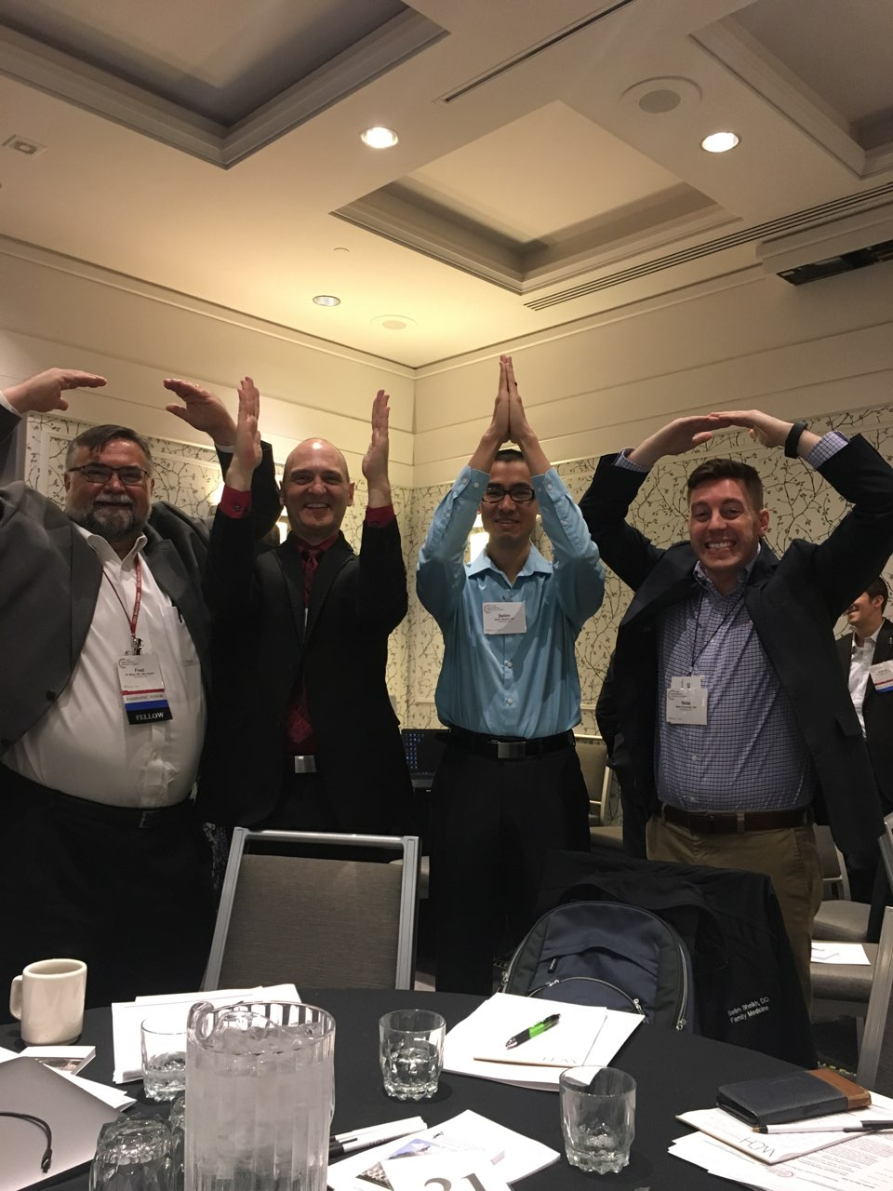
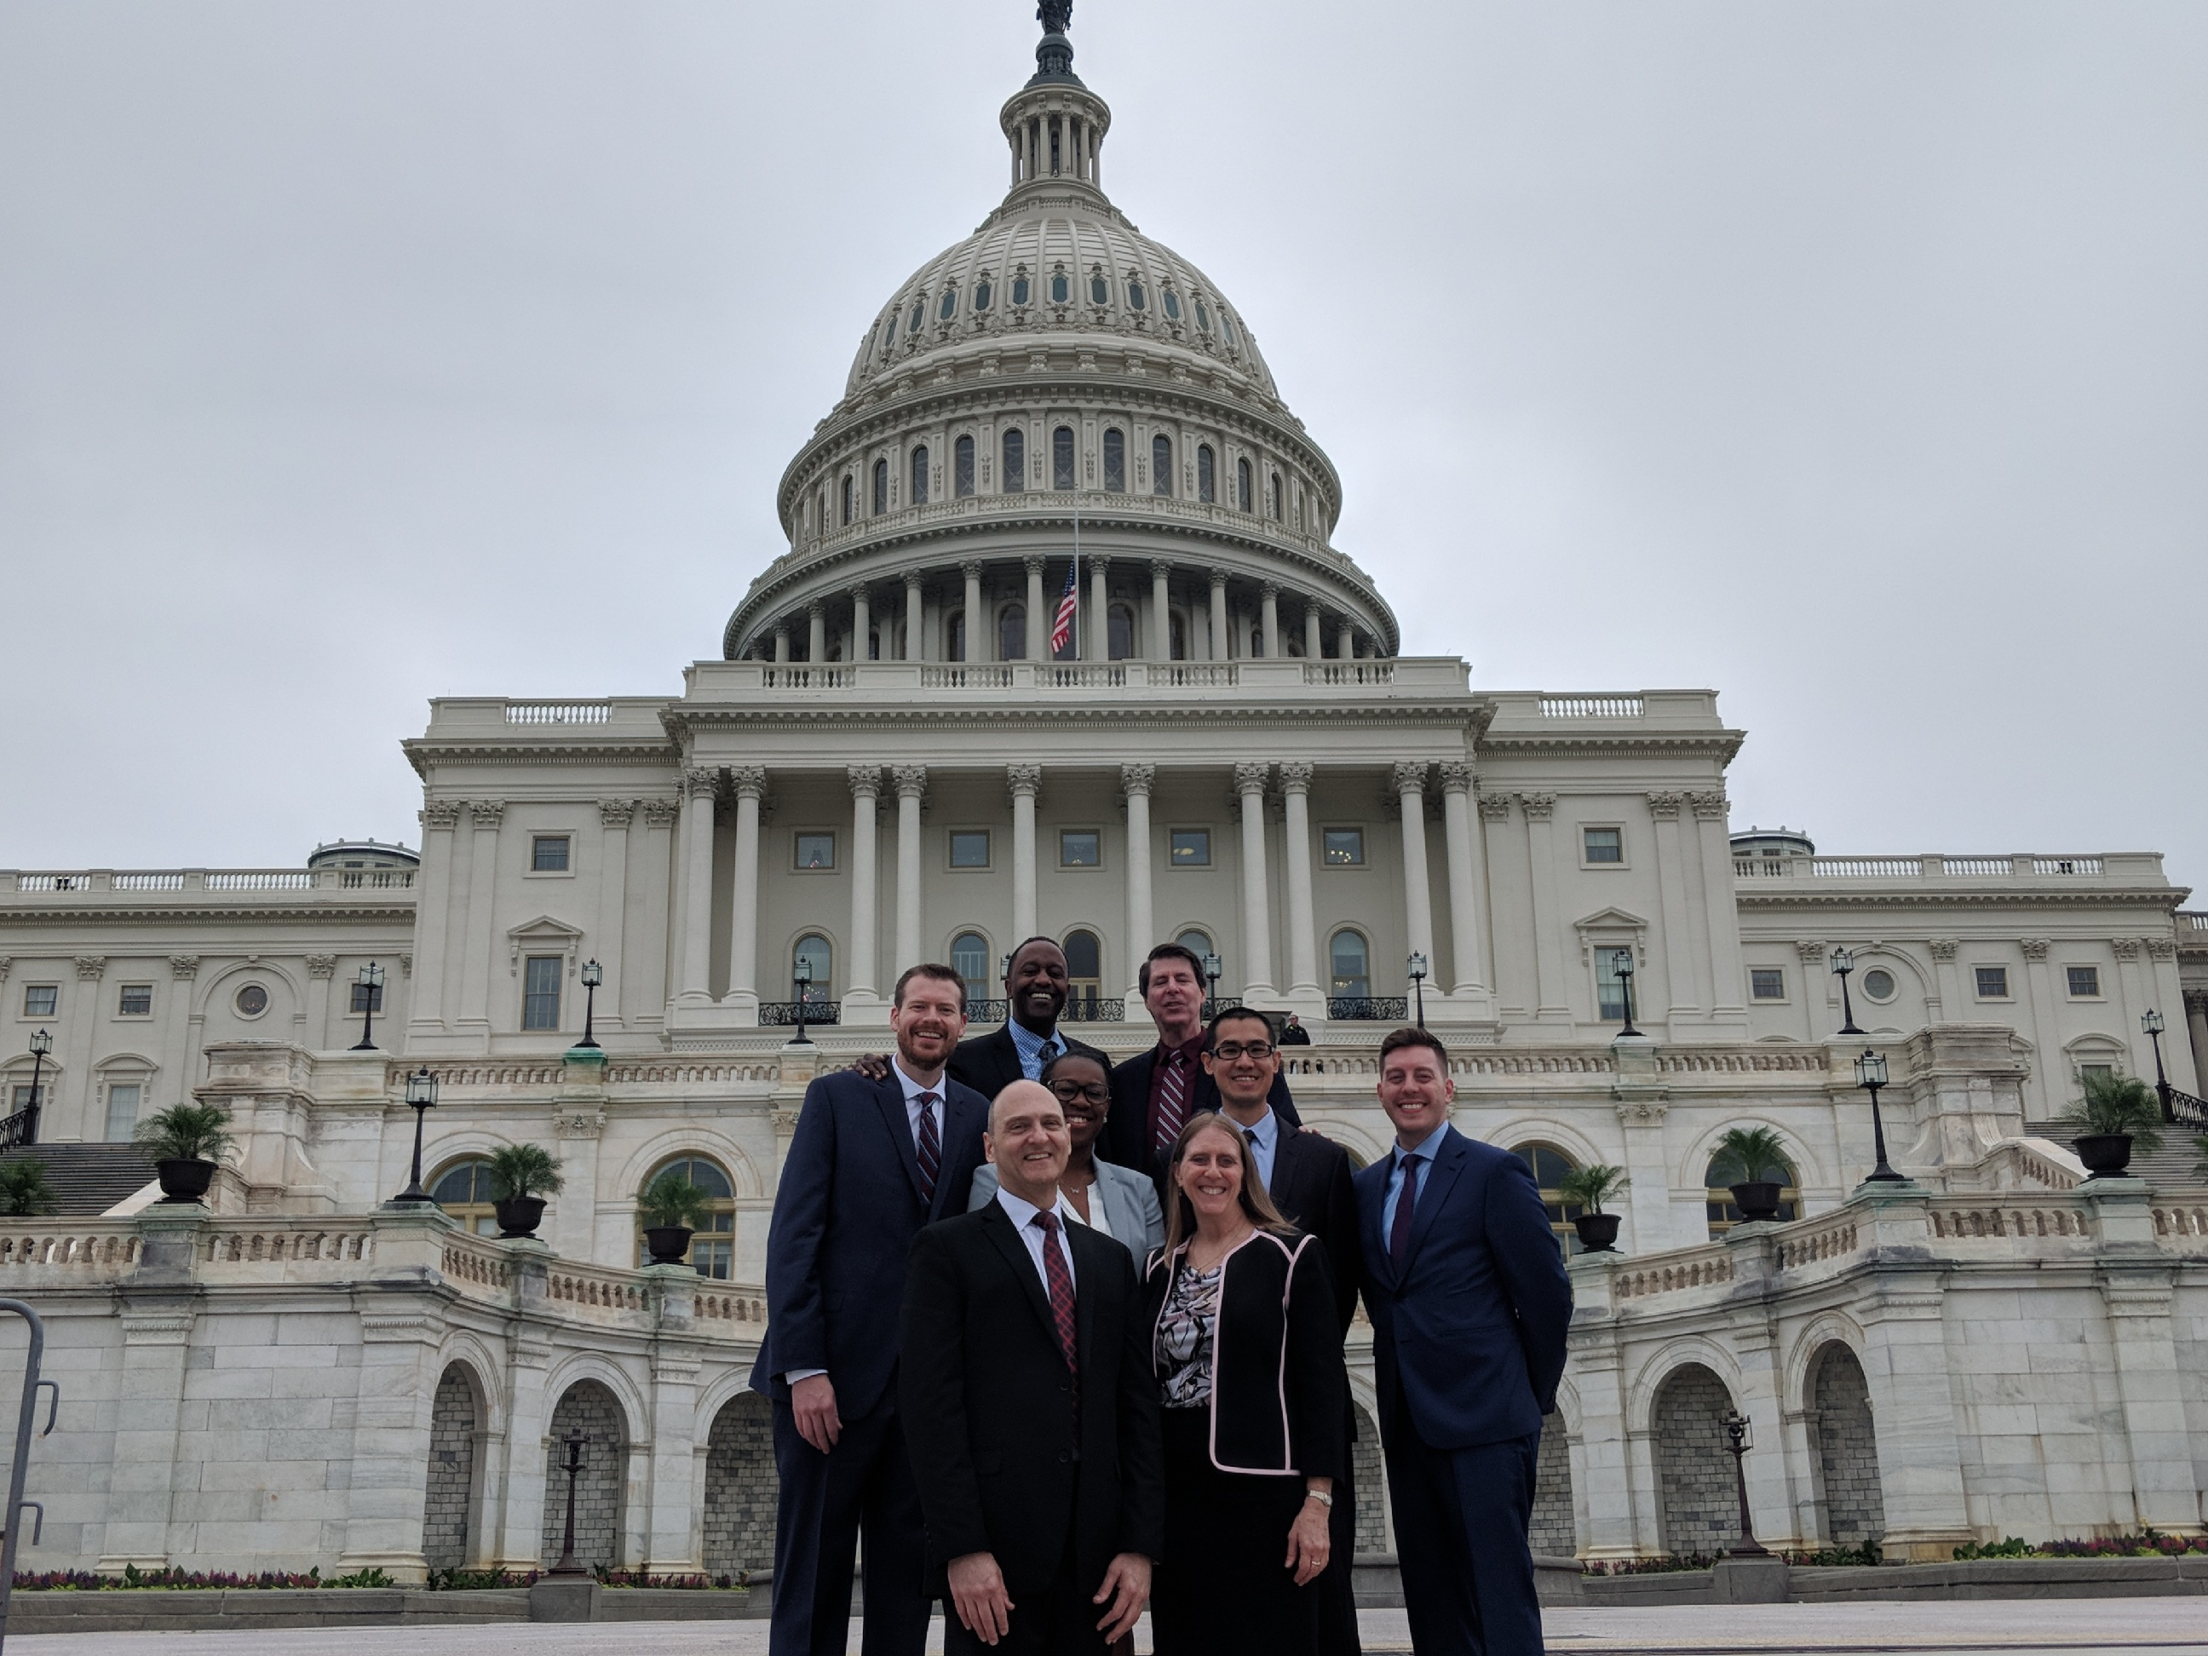

Slide 12
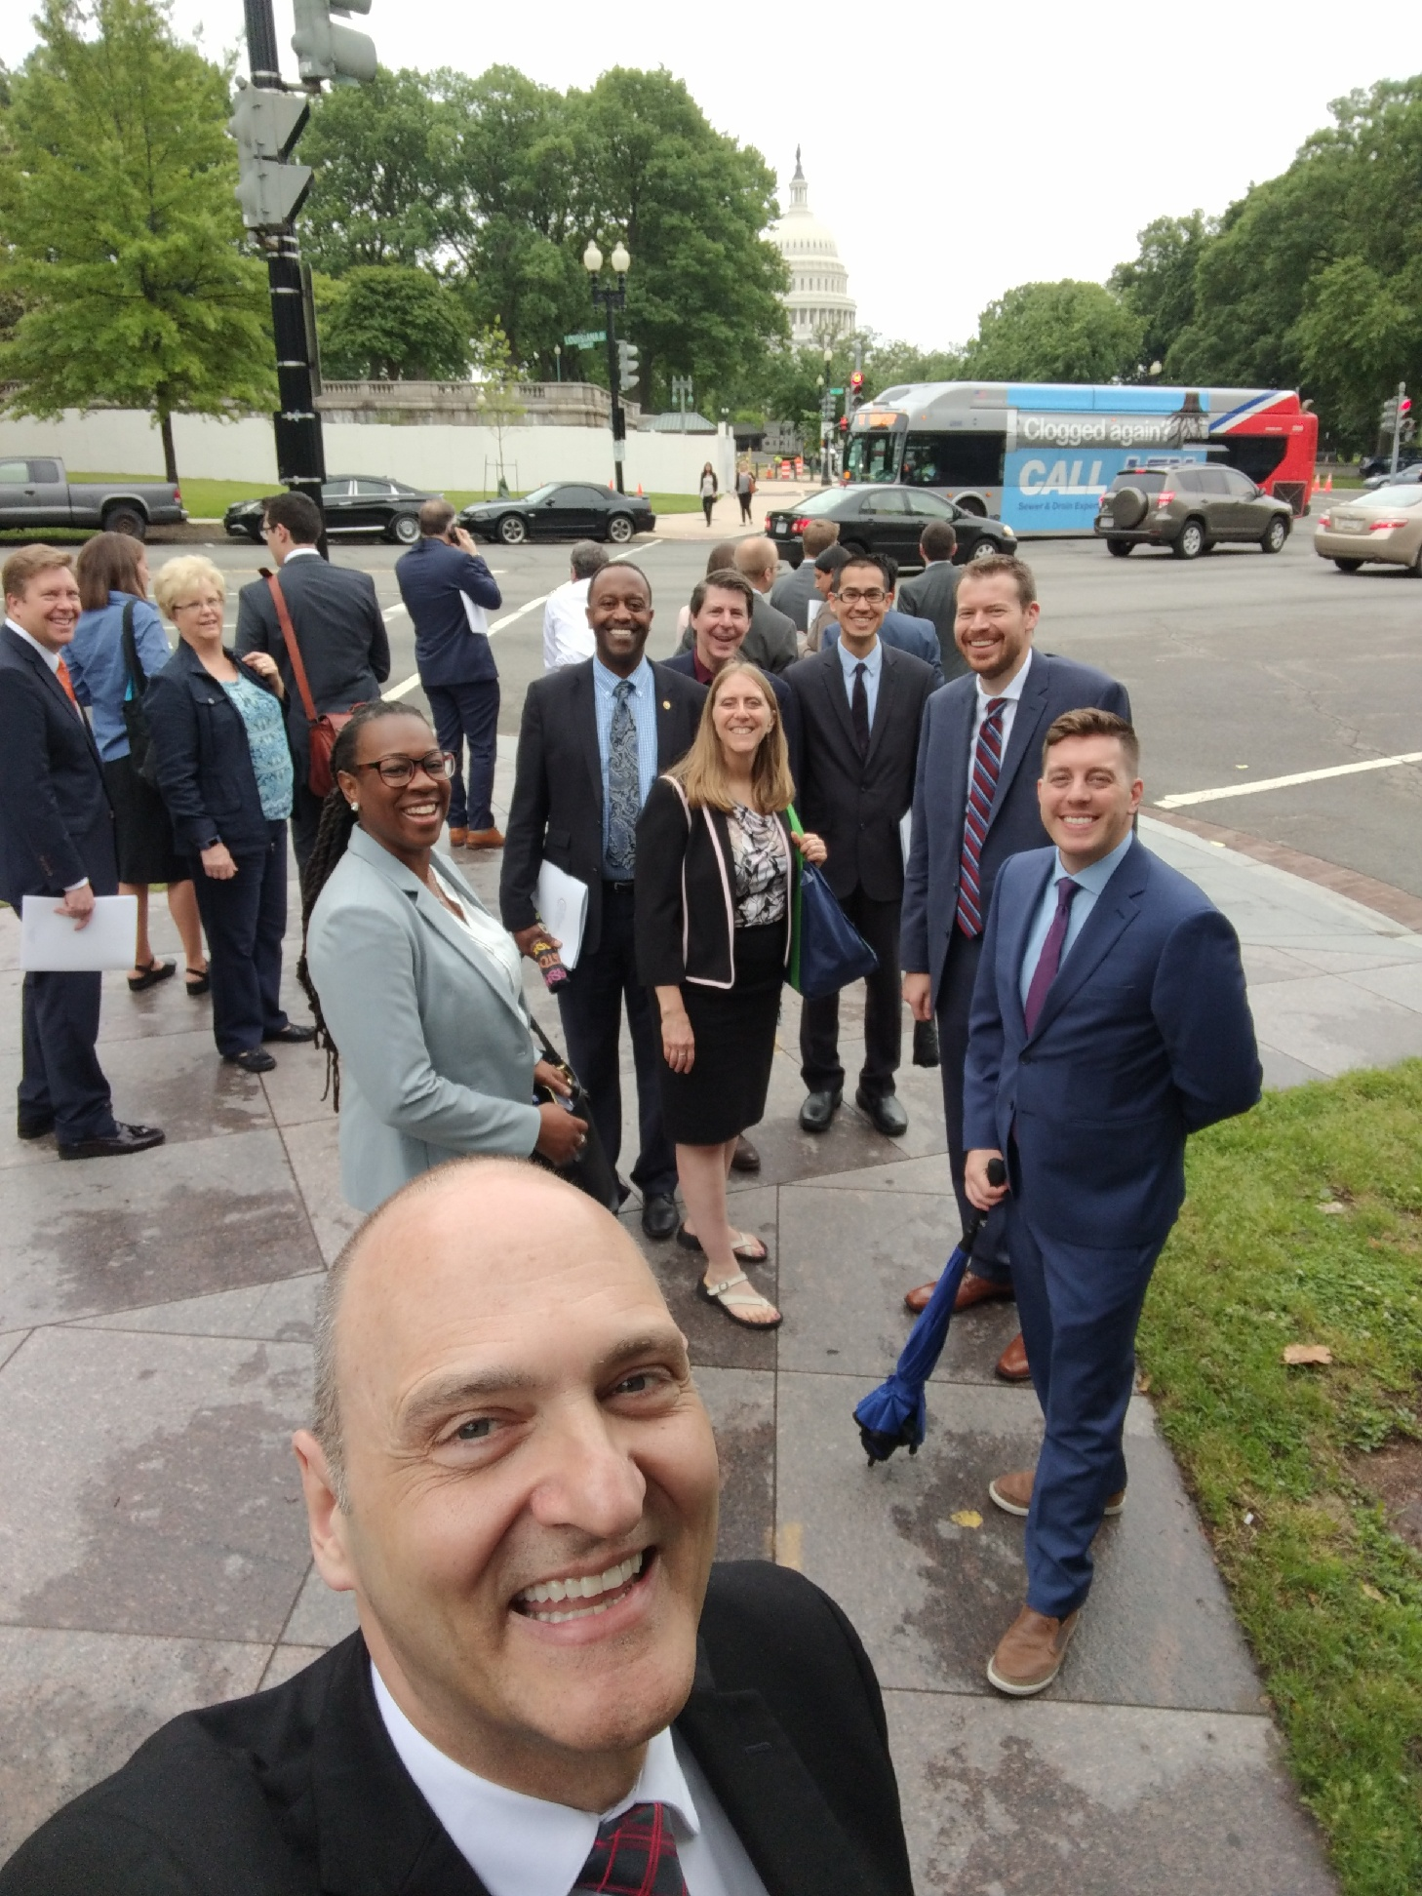
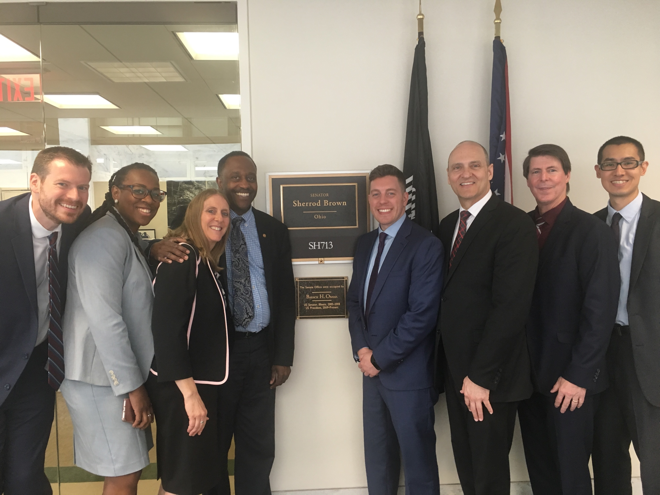

Slide 13
Family Medicine Advocacy 101

Slide 14
Getting Started in Advocacy
Advocacy is “the act or process of supporting a cause or proposal.” – Merriam-Webster
Where can you advocate?
Home
Residency program/medical school
Legislator’s local office
State capitol
Washington, D.C.
Notes:
Defends → teaches, engages, listens, provides solutions.
The goal of advocacy is two-fold:
Short-term: build relationships
Long-term: have your cause supported

Slide 15
The Process of Advocacy

Slide 16
Prepare and Make Contact
Gather information
Learn about your legislator
https://grassroots.aafp.org/aafp/billtracker?2
Determine your ask
Make contact

Slide 17
The One-Pager
Ask
Background
Supporting arguments
Personal anecdotes
Notes:
The ask is the most important part. Put this at the beginning and make sure everything that follows supports it.
The background section gives the legislator an understanding of what the problem is, why a solution is necessary, and a reason to put this on their agenda.
Supporting arguments help strengthen the ask by giving it heart. Anecdotes from personal experience or clinical practice give legislators a story to remember, which helps promote your agenda.
Some important things to remember about one-pagers:
Make copies of the one-pager
Memorize key points
Avoid medical jargon
Avoid uncertainty
Make it yours
The recommendation at the top explicitly states what action is needed.
The background section includes a description of the problem and provides critical context for your Ask.
The rest of the one-pager is made up of the background section.
The background section provides your talking points, including the benefits of the Ask.
Add a personal touch if possible – to personalize the issue for your legislator.

Slide 18
The One-Pager

Slide 19
The Visit
Use your one-pager as a set of talking points
Know your facts
Know the details of specific bills
Know the pros and cons of your position
Make it personal
Notes:
Ending the visit:
Be clear about your ask
Try to get a direct response
Offer to be a resource
Get staff’s direct email
Restate your follow-up promises
Thank them

Slide 20
Maintaining the Relationship
Be a resource to your legislator on health care and health system issues
Check in once a quarter
Share an article
Say hello at events
Call to discuss key issues
Invite your legislator/staff to your institution

Slide 21
https://www.aafp.org/advocacy/involved/toolkit.html
Family Medicine Action Network
Letter writing
Meet with your legislator
FamMedPAC
FMAS!
In the Trenches
http://www.ohioafp.org/public-policy/be-your-own-advocate/

Slide 22
References
http://www.ohioafp.org/public-policy/
http://www.stfm.org/Advocacy/AdvocacyCourses
https://www.aafp.org/advocacy.html
https://www.aafp.org/events/fmas.html

