Slide 1
FMAS

Slide 2
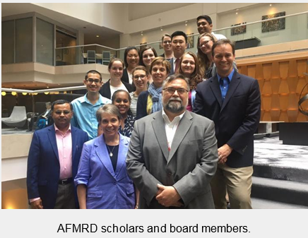
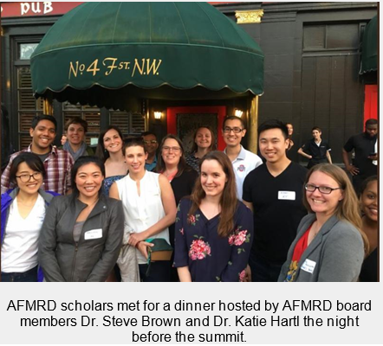
Thank you AFMRD!
I received a $1500 scholarship to attend thanks to Association of Family Medicine Residency Directors.
Now I need to spread the love…
Notes:
Dinner the night before the conference. Meeting with residents and 2 other PDs from around the country.

Slide 3
#FightingforFamilyMedicine
Two Day Conference
Day 1: Talks on policy, overview of legistlative efforts, How to Advocate on the Hill, Media Perspective, Advocacy Resources, US Senator Cory Gardner
Day 2: Visits on the Hill
Notes:
Give details as to the talks and visits.

Slide 4
Take Home Points
AAFP 2018 Legislative Priorities
improving access to primary care through affordable insurance
expanding rural healthcare
finding solutions to the opioid crisis
preventing maternal mortality
Notes:
Pass out the briefing sheets on each of the priorities.

Slide 5
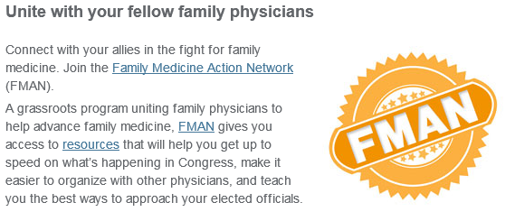
The AAFP is working on expanding their advocacy footprint.
https://www.aafp.org/advocacy.html

Slide 6
How can you get involved?

Slide 7
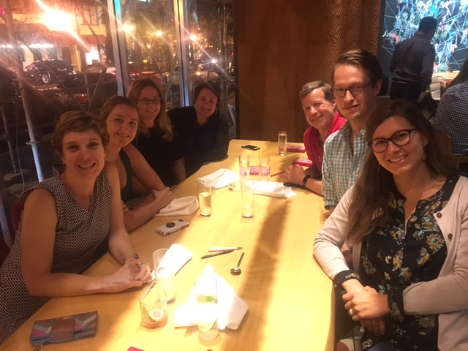
Networking!
https://mafp.org/
Notes:
Spending time with MN folds. Executive Director of the MAFP, President of the MAFP, 2 active residents,

Slide 8
Advocacy with your checkbook/credit card

Slide 10
Visits to the Hill

Slide 11
What can you do?
Think about your level of engagement
Local
State
National
Local Options
MAFP Advocacy Workshop January
MMA Day at the Capitol March
Notes:
Brainstorm other options for different levels of involvement.

Slide 12
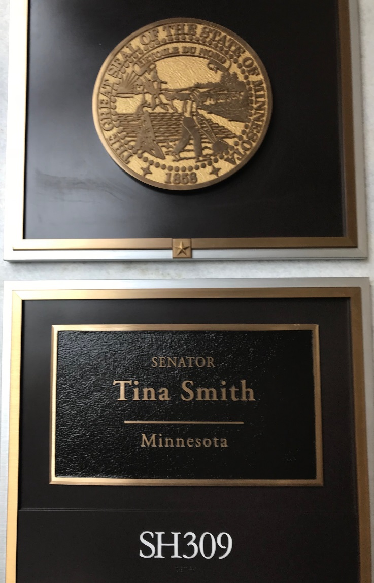
Visits to Senators Tina Smith’s office and Congressman Keith Ellison’s office
Notes:
Discuss experiences with the Legislative Aides. What we shared. How it worked.

Slide 13
Next Steps here at home
Advocacy Curriculum
Informal Advocacy Get-Togethers
What else???

