Slide 1
Family Medicine Advocacy Summit
Mylanie Facelo, DO
JMH FM Resident
6/14/17

Slide 2
Background

Slide 3
AAFP Family Medicine Advocacy Summit
What is it?
Annual 2 day advocacy-centered event/conference in Washington, D.C hosted by AAFP with the intent:
to empower members with the most up-to-date information on our most important issues
GOAL:
to better understand federal and state advocacy
learn about the current priorities for family medicine
receive practical, hands-on experience with the legislative process.

Slide 4
AAFP Family Medicine Advocacy Summit
Ways to go to this conference as resident
American Academy of Family Physicians (AAFP )
Routine
Scholarship
4 Residents
Association of Family Medicine Residency Directors (AFMRD)
Scholarship
10 Residents

Slide 5
AAFP Family Medicine Advocacy Summit
My Why
Background advocacy
Introduction
State level
To learn how to advocate in DC
Professional reason
Patients
Profession
Personal reason

Slide 6
Preparation

Slide 7
AAFP Family Medicine Advocacy Summit
Application
Email received with instructions of opportunity
Website for application
Letter of recommendation

Slide 8
AAFP Family Medicine Advocacy Summit
As AFMRD Winner
Email received with instructions
Registration
Lodging
Travel arrangements and time frame
AFMRD Dinner for winners
Advocacy Course
Essay or Presentation

Slide 9
AAFP Family Medicine Advocacy Summit
Advocacy Course
Society of Teachers of Family Medicine (STFM)
5 online modules
Getting started
Prepare and make contact
The one pager
The visit
Maintaining the relationship

Slide 10
AAFP Family Medicine Advocacy Summit
Getting started
Introduction to Advocacy
Different reasons people started
Where can you be an advocate
At home via email, phone, letters, fax
Residency program/Medical school
Local legislatures office
State capitol
Washington, DC
Key people

Slide 11
AAFP Family Medicine Advocacy Summit
Prepare and Make Contact
AAFP contact
Help organize
Provided contact with others in the State
Encouraged contact
Senators
Representatives
Staff
How to contact
Visit
Email
Call

Slide 12
AAFP Family Medicine Advocacy Summit
The one pager
Consist of
Ask
Background
Supporting arguments
Personal anecdotes
Notes:
Hand out one pagers from conference to audience

Slide 13
The Visit

Slide 14
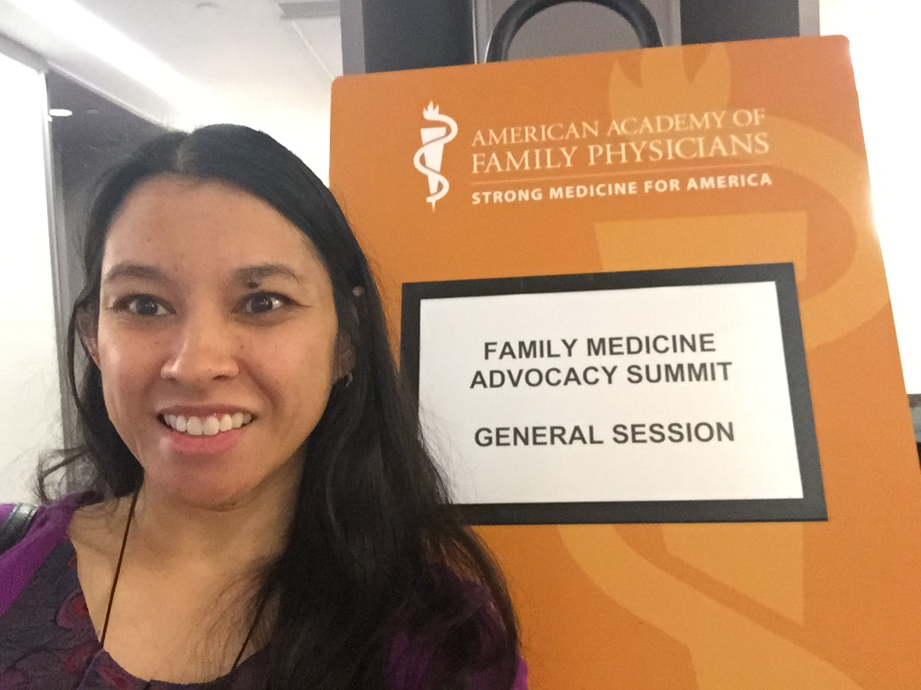
Notes:
I made it

Slide 15
AFMRD Winners

Slide 16
AAFP Family Medicine Advocacy Summit
Conference
Dinner Night before for winners
1st day
More education on the different topics (more than listed)
Health Care Reform
Teaching Health Centers
Breakout sessions- lobbying 201
Practice for the next day
2nd day
Lobby

Slide 17
State Capitol

Slide 18
AAFP Family Medicine Advocacy Summit
Visit Summary
Discussed
Healthcare Coverage Gains
Teaching Health Centers
Public Health and Research Priorities
Congressional Primary Care Caucus
Notes:
Address one pagers handed out for each

Slide 19
Post Conference

Slide 20
AAFP Family Medicine Advocacy Summit
Maintain relationships
Provide cards
Email
Provide updates and more information
Share with others
Notes:
Address one pagers handed out for each

Slide 21
AAFP Family Medicine Advocacy Summit
Questions????
Notes:
Address one pagers handed out for each

Slide 22
AAFP Family Medicine Advocacy Summit
Resources and how to get involved
AAFP: www.aafp.org
AFMRD: www.afmrd.org
STFM: www.stfm.org
Notes:
Address one pagers handed out for each

Slide 23
