Slide 1
Using EPAs to Develop Resident Learning Plans
AFMRD EPA TASK FORCE

Slide 2
Goals
As a result of this presentation participants will:
Understand how Entrustable Professional Activities can aid in developing individual resident learning plans.
Utilize EPAs and related mapping documents to facilitate remediation for residents.
Utilize EPAs and related mapping documents to develop aspirational learning plans for the high-performing resident.

Slide 3
What is an EPA?
A task or responsibility ENTRUSTED to unsupervised execution by a trainee once sufficient specific competence is obtained.
Independently executable, observable, and measurable.
Written to describe activities that Family Physicians will perform when they are in independent practice.

Slide 4
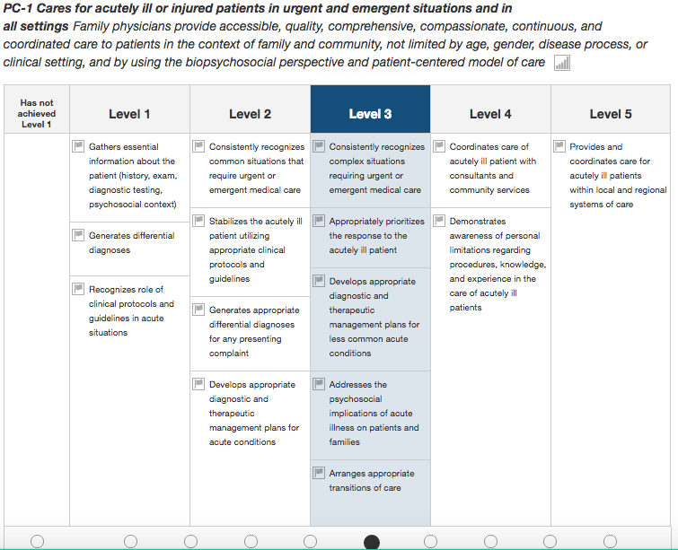
General
Competency
Subcompetency
Developmental progression or set of MILESTONES
Milestone Description
Milestone Level

Slide 5
Entrustment Mapped to Subcompetency
Achievement entrustment will back fill to subcompetencies

Slide 6
Why use EPAs in Learning Plans?
EPAs describe performance of clinical activities.
Matches language used by some outside evaluators.
Matches language used by some learners as they plan for future practice.
Can be a useful bridge between the language of competency domains and activities performed.

Slide 7
Learning Plan Development: Residents Requiring Remediation
Residents struggling with a particular subcompetency frequently fail to recognize the necessity for competence in that specific skill.
You can now “reverse map” from that subcompetency to the EPAs they will be unable to perform due to that lack of competence.

Slide 8
Learning Plan Development: Residents Requiring Remediation (cont.)
Preceptors - particularly non-academics – may be more likely to talk entrustment rather than competency.
(e.g. “they just can’t tell how sick a patient really is!”)
Translate that comment into subcompetency and milestone-based goals for the resident.
(For the above example: EPAs #6 through #9 – depending on the diagnosis)

Slide 9
Learning Plan Development: On-track and High-functioning Residents
Residents wishing to ensure they can fill a particular niche, or striving for excellence in a particular area can be directed to the relevant EPA(s).
Preparation for fellowship acceptance
Leadership careers
Future faculty
Advocacy
They can then use the higher level milestones in the associated sub-competencies as a roadmap for achieving their goal.

