Slide 1

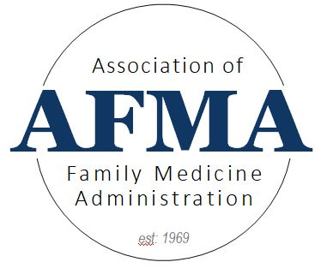
August 17, 2026
Revising Application Review Processes

Slide 2
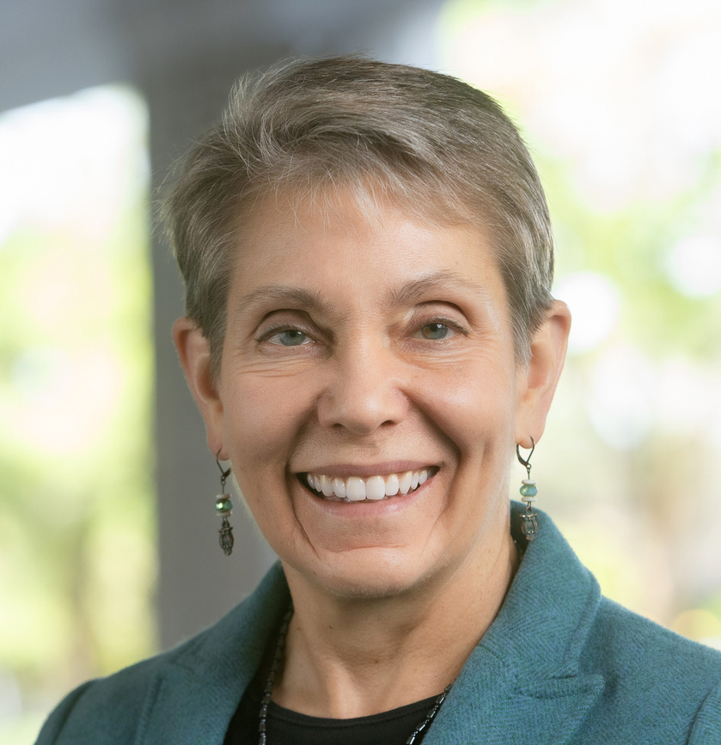
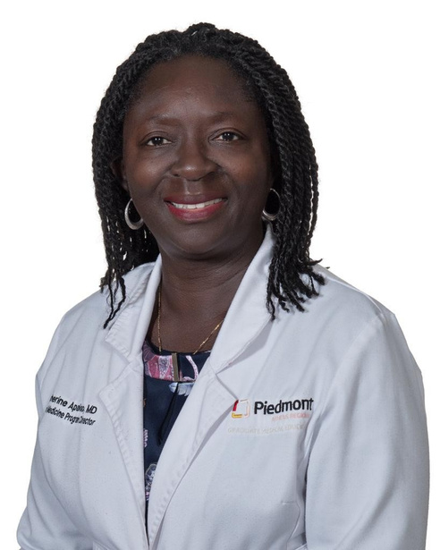
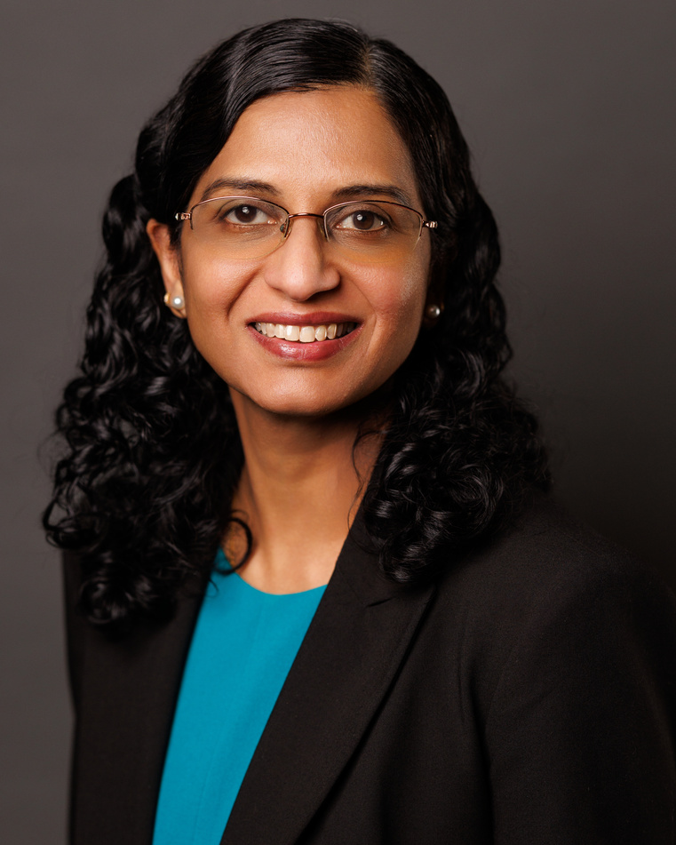
Today’s Panelists:
Karen Mitchell, MD, FAAFP
Catherine E. Apaloo, MD, FACP
Varshaben Songara, MD, MHPE
AAFP Vice President National Residency and Academic Partnerships
Senior Vice President and Chief IMG Experience Officer, Intealth
Associate Program Director, Harnett Health Family Medicine Residency

Slide 3
Residency Selection Improvement Initiative
Residency Selection Improvement Initiative
Karen Mitchell, MD, FAAFP
Vice President For National Residency and Academic Partnerships, AAFP
Notes:
Thank you for inviting me. I am Dr. Karen Mitchell, former program director, and now AAFP VP for National Residency and Academic Partnerships.
Thank you to our FM organizations for being involved in this initiative, led by AAFP, to improve the systems and processes of residency selection and recruitment in family medicine.
This initiative started with a discussion between myself and the AFMRD leaders after the 2025 Match, feeling the effects of an increased number of unfilled positions in the Main Match. We discussed how challenging the current residency recruitment process is.

Slide 4






































Residency Selection and Improvement Initiative (RSII)
Goal: Fill all family medicine residency positions in the most effective, efficient and
economical way possible.
Help applicants find FM programs that align with their values and interests | Help residencies find the best applicants for their programs
Create a One-stop Information Tool
Re-imagine the
Interview Process
Improve Residency Selection and Match for International Medical Graduates and Multi-specialty Applicants
Support Dedicated FM Applicants
Streamline the process of finding FM residency information for applicants.
Because of RSII: The Residency Explorer™ tool and Careers in Medicine® now feature AAFP and ABFM data on the FM specialty profile, alongside FM-specific details on individual program pages, streamlining the research process for applicants.
Make the interview process easier, equitable, effective and efficient for residencies and applicants.
Because of RSII: The Program Directors Association Guide for Applicants for FM now features six workgroup recommendations regarding interview offer and acceptance timelines. RSII has developed a dedicated explainer to help provide the rationale and context for these guidelines.
Increase the number of high-quality IMG and multi-specialty applicants who are selected for interview.
Because of RSII: Current workstreams focus on three areas: resources to help programs identify qualified IMG and multi-specialty applicants; targeted guidance and tools to debunk myths surrounding non-U.S. IMG visa processing; and structural input on a new FM-specific indicator to better capture applicant interest.
Make the matching process more efficient and economical for programs and applicants.
Overall Strategy: Support FM-dedicated applicants by helping programs better understand existing residency selection pathways, alongside working with the AAMC and NRMP to explore potential pathway opportunities.
RSII North Star Leadership Group: Strategic support and guidance provided by residency program directors, program coordinators/administrators, medical school advisors and students/residents.
For more on RSII visit: https://www.aafp.org/residency-program-directors/residency-selection-improvement-initiative-rsii
June 2026

Slide 5
#3. Improve Residency Selection and Match for International Medical Graduates and Multi-specialty Applicants

Slide 6
Number of Positions Filled, by Year
6

Slide 7
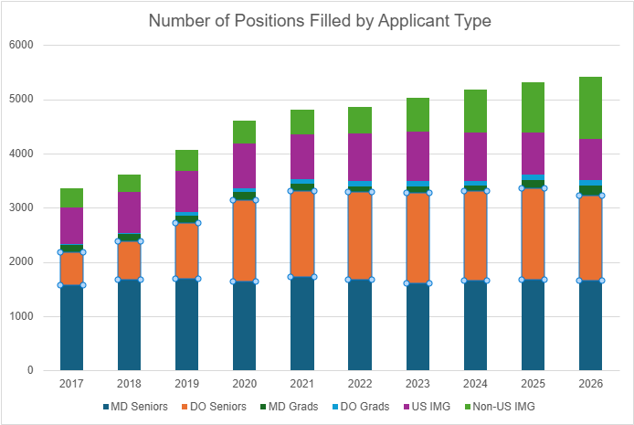
Total Positions Filled by Applicant Type
Data provided courtesy of the NRMP.
7

Slide 8
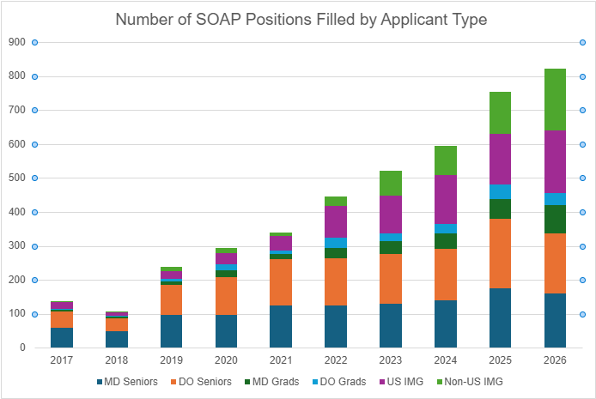
SOAP Positions Filled by Applicant Type
Data provided courtesy of the NRMP.
8

Slide 9
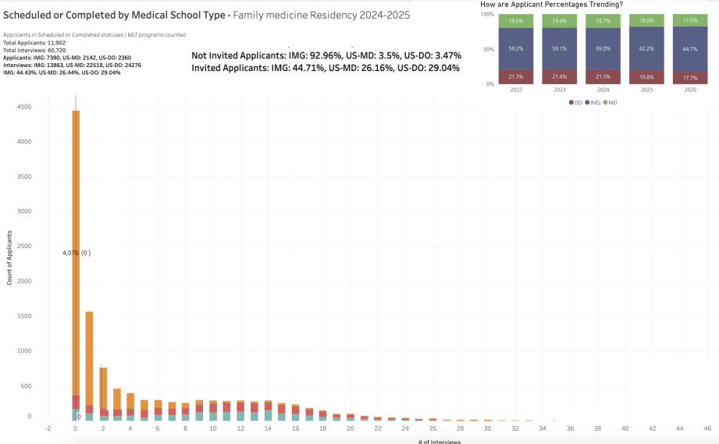
Priority 3: IMG/Multi-Specialty Data for FM (‘24-‘25)
There are ~11,000 applicants for approximately 5,000 PGY-1 positions. Of those, about 5,000 receive only one or no interview offers
High cross specialty applicants: 11K FM applicants → 16K to all specialties
Opportunity insight: Expand the pool of applicants being considered
Source: Provided by Thalamus
9
Notes:
Based on data reviewed, there are a number of highly qualified applicants who are going basically unseen by programs. Using data, the approach is to identify some guidance to programs about how they can find those highly qualified applicants that they might otherwise miss based upon their interview selection process and criteria. And likewise, to identify which of the cross-applying applicants are not just using FM as a backup, but rather those who are genuinely still deciding which specialty they want. Therein is our opportunity to show those applicants what family medicine is about by highlighting what the residency program has to offer.
Include FM Badge development opportunity--partnership with Thalamus
2025-26 data very similar: 12,000 applicants, about 4000 with no interview offers (1/3 of applicants). 95% of those are IMGs.

Slide 10
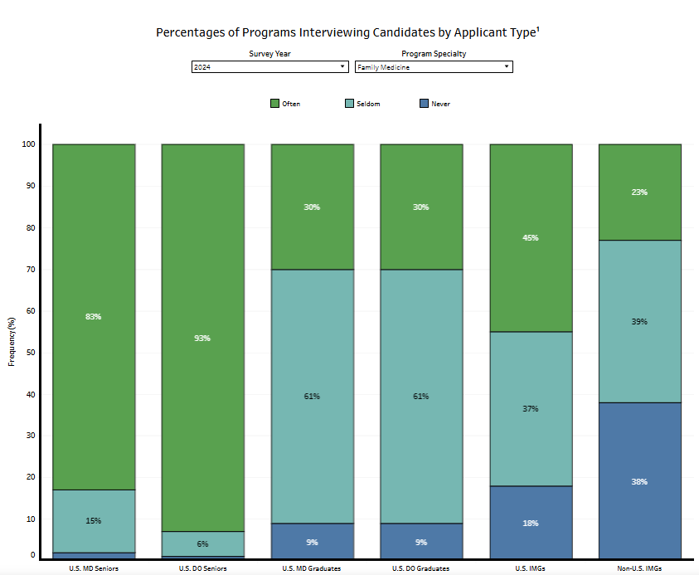
FM Program Interview Rates: IMGs and DOs
FM PDs interview IMGs at lower rates than U.S. MD and DO graduates
Source: NRMP Charting Outcomes™: Program Director Survey Results, 2024 Main Residency Match
Notes:
Overall and across applicant type single applicants are invited to interview at higher rates than multi-specialty applicants meaning programs are able to discern to a certain degree which applicants are genuinely interested in family medicine.

Slide 11
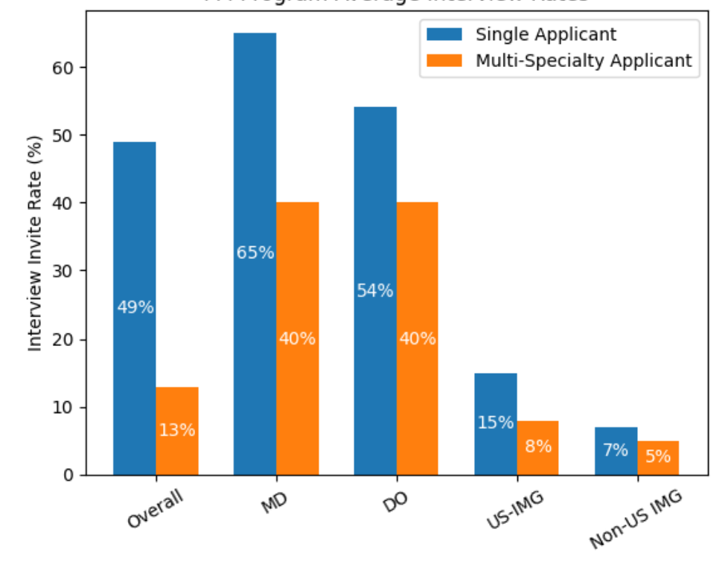
FM Program Interview Rates: Single vs. Multi-Specialty
Overall, and across applicant type, single-specialty applicants are invited to interview at higher rates than multi-specialty applicants
→ Programs are able to discern to a certain degree which applicants are genuinely interested in family medicine.
Notes:
Overall and across applicant type single applicants are invited to interview at higher rates than multi-specialty applicants meaning programs are able to discern to a certain degree which applicants are genuinely interested in family medicine.

Slide 12
Programs that Attract FM-Only Applicants
Source: AAMC 2025 Match Data
12
Notes:
Urban programs tend to attract a baseline level of FM-only applicants, while suburban and rural programs draw more FM-leaning multi-specialty applicants, or those who apply to a minority of FM programs but also hedge with other specialties.

Slide 13
Multi-Specialty Applicants: Key Associations
More likely to apply to multiple specialties:
  Reapplicants
  IMGs
  Education-related experience
  Journal article experience (even if not published)
  (Higher odds: ~1.4-4.9x likely)
Less likely to apply to multiple specialties:
  MD or DO graduates
  Extracurricular, volunteer, or teaching experience
  (Lower odds: ~0.85–0.95× likely)
13
Notes:
-Signaling did not guarantee an interview, but not signaling greatly decreased the odds of receiving an invitation to interview.
-Applicants who signaled and whose geographic division preference aligned had the higher invited to interview rate (52%).
-The number of applications submitted per applicant decreased significantly.^{1 ERAS}
-These findings indicate that signals are functioning largely as intended in family medicine. While signaling applicants are more likely to receive interviews, invitations remain open to non-signaling applicants as well. This balance allows residency programs to increase their Main Match fill rates while maintaining selection flexibility.

Slide 14
Identifying Mission-Aligned Applicants
Highlight Program Strengths and Clarify Recruitment Process
“Screen in” Applicants
  Mission-aligned application review
Identify “FM-Leaning Attributes”
  Sustained service/volunteer work, teaching/mentoring, longitudinal community engagement, credible geographic ties, and FM-focused letters
Capitalize on Program Signaling
Optimize Interview Invitations and Selection
  Include strong “FM-leaning” multi-specialty candidates
Structure Flexible and Equitable Interview Formats
  Consider alternative ways to highlight your program (without affecting rank list)

Slide 15
Practical Strategies for FM Recruitment
Build FM-leaning shortlists
  Prioritize clear FM attributes: sustained service/volunteer work, teaching/mentoring, longitudinal community engagement, credible geographic ties, and FM-focused letters
  Look for primary care endorsements or focus on primary care in LORs, electives and clerkship selections, and unique, personal lived experiences
Avoid proxy assumptions
  IMG/reapplicant ≠ low commitment
  Multi-specialty behavior may reflect risk management
  Remove broad screens (e.g. years since graduation) and focus on FM alignment
Use interviews strategically
  Single-specialty applicants already get more interviews; shift some interviews toward FM-leaning applicants to avoid missing them
  Capitalize on program signaling
  Drive early interview offers using signals and publish how your program views and uses signals clearly
Notes:
Actionable insight for program directors: Treat “FM commitment” as a scarce signal and actively screen in the FM-leaning middle (FM-majority) before it shrinks further, using observable FM-alignment proxies rather than assuming broad portfolios = low interest.
Net result: you preserve and potentially rebuild the FM-majority segment (which has been shrinking) without lowering standards, by focusing selection effort on signals of FM identity and mission fit that programs can actually observe.

Slide 16
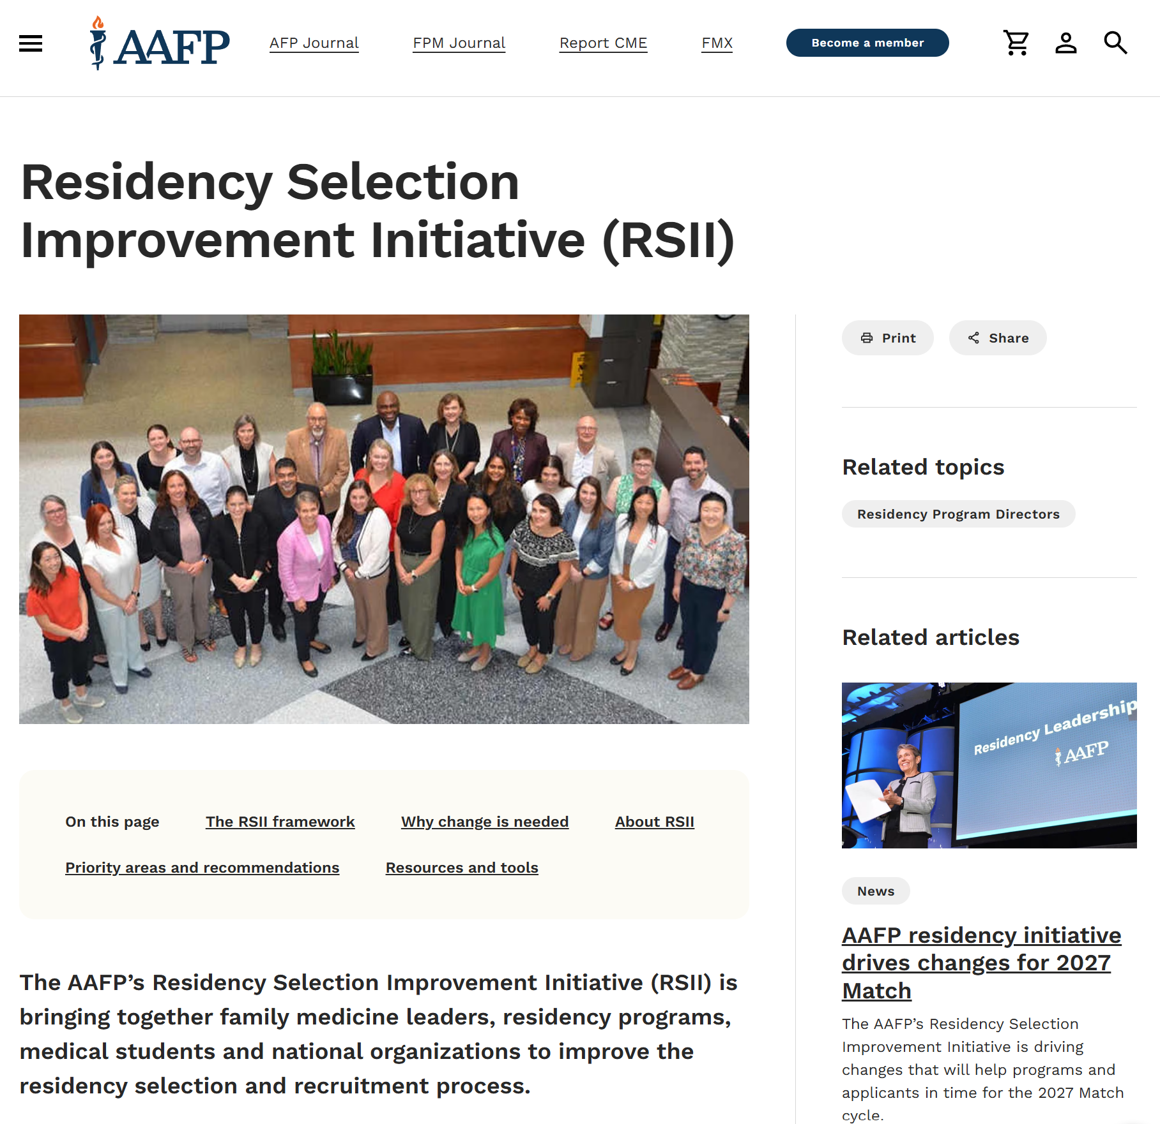
Questions?
Contact us.
kmitchell@aafp.org
Webpage at aafp.org: Residency Selection Improvement Initiative (RSII) | AAFP

Slide 17
International Medical Graduates
Journey to GME
Catherine Apaloo MD FACP
SVP and Chief IMG Experience Officer, Intealth
August 17, 2026

Slide 18
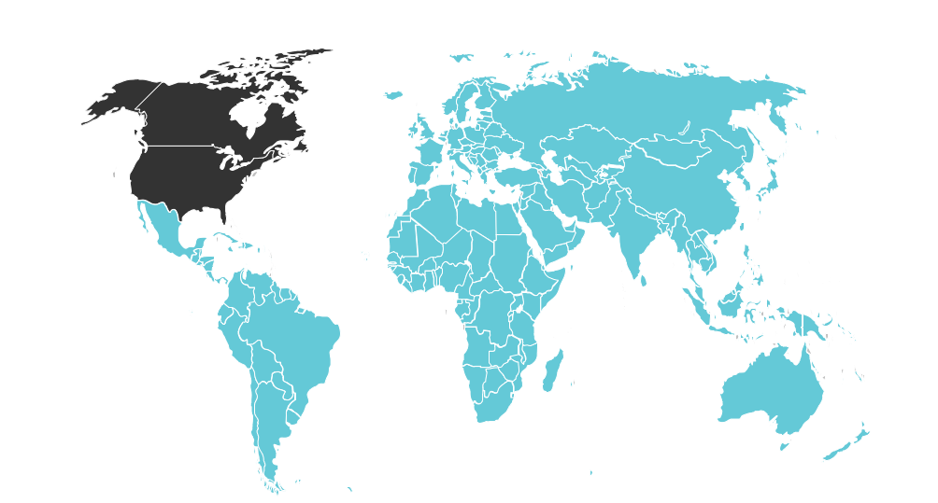

Who is an International Medical Graduate (IMG)?
An IMG is a physician who received their basic medical degree from a medical school located outside of the United States
IMGs comprise approximately
25%
of the U.S. physician workforce
Copyright © 2025 by Intealth. All rights reserved.

Slide 19


IMG Profiles
Foreign Citizen IMGs
U.S. Citizen IMGs
Majority apply to ECFMG as graduates
Require a visa for GME
  J-1 or H-1B; other visa types
Transition to GME is often different, longer
~70% of IMGs
Majority apply to ECFMG as students
Do not need a visa
Same/similar path as U.S. MDs
Many attend medical schools in the Caribbean or Eastern Europe
~30% of IMGs
Notes:
“When we say ‘IMG,’ we are actually talking about two very different populations—foreign national IMGs and U.S.-citizen IMGs—with distinct pathways, timelines, and support needs.
Treating them as a single group is one of the system’s most common design flaws.”

Slide 20
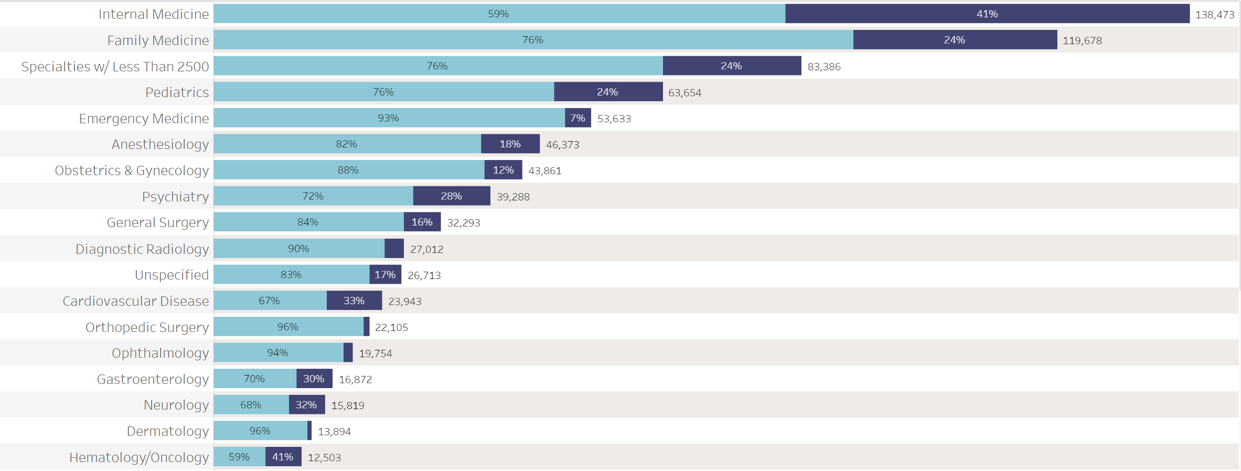
Active Physicians by Specialty & IMG Status
Notes:
“IMGs are not evenly distributed across specialties. They are disproportionately represented in areas already experiencing shortages—internal medicine, psychiatry, pediatrics, and subspecialties critical to aging populations.”

Slide 21
Country of Medical School
Over the last 5 years, ECFMG has Certified applicants who attended medical school in
163
different countries
Copyright © 2025 by Intealth. All rights reserved.

Slide 22
Country of Citizenship
Over the last 5 years, ECFMG has Certified citizens of
177
different countries
*Citizenship is at the time of entrance to medical school
Copyright © 2025 by Intealth. All rights reserved.

Slide 23
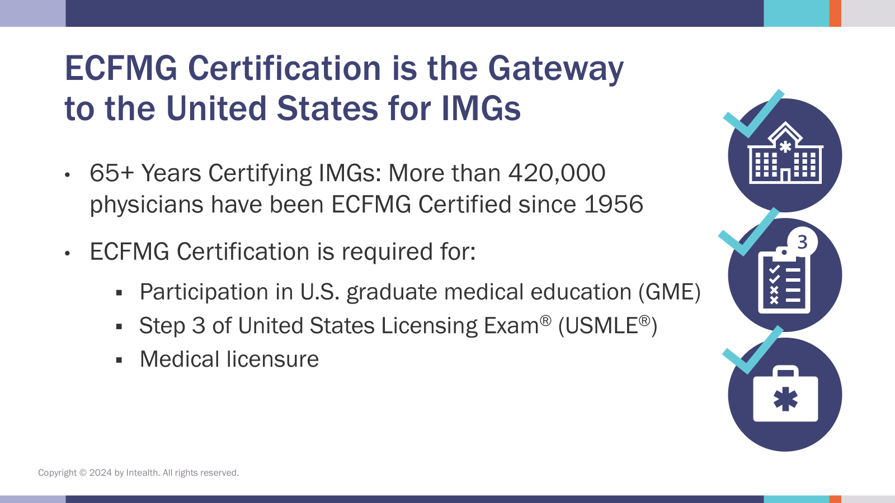
Becoming a U.S. Physician
Include UPDATED IMG Journey Slide
Medical School Degree
Full Licensure
Board Certification
Licensing Examinations
Graduate Medical Education (Training)
Copyright © 2025 by Intealth. All rights reserved.
Copyright © 2025 by Intealth. All rights reserved.
Notes:
What is the purpose of ECFMG certification?
•Has operated continuously for nearly 70 years
•Evaluates readiness of IMGs to enter U.S. GME
•Assures public that IMGs are appropriate for supervised patient care
•Provides a way for qualified IMGs to learn and train in the United States
•Brings diversity to U.S. GME programs

Slide 24
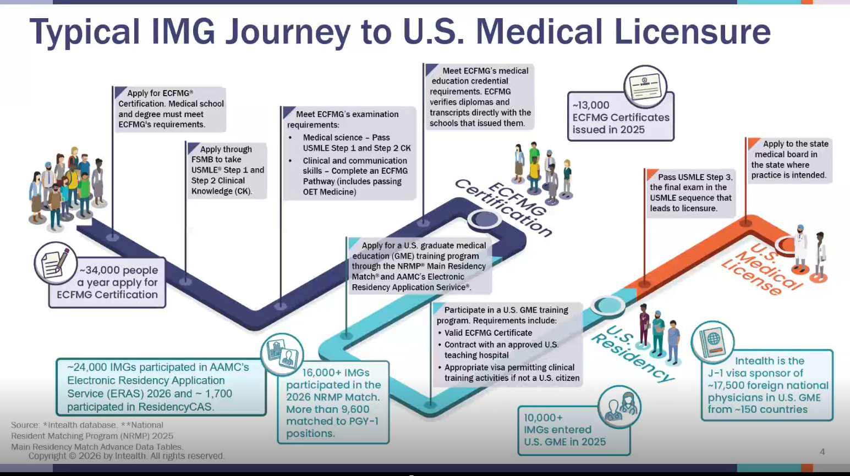

Slide 25
IMG Path to U.S. GME
ECFMG Certification Match GME
~35,000
~19,000
~9,000
USMLE Step 1
Apply to Residency (ERAS)
Obtain visa if foreign citizen
Medical License
Board Certification
USMLE Step 2 CK
If medical school and degree meet ECFMG requirements, IMG can apply for ECFMG Certification
Pathway/OET
+ verification of medical school diploma and transcript
~3 Year Process
Notes:
What does it take to be ECFMG certified?

Slide 26
Satisfy Certification Requirements
Meet Eligibility Requirements
Examination Requirements
Medical Education Credential Requirements
www.ecfmg.org/certification
Copyright © 2025 by Intealth. All rights reserved.

Slide 27
Meet Eligibility Requirements
Medical School Requirements
Attended a medical school that is eligible for ECFMG Certification
Individual Requirements
Identity Verification
Acceptable Graduation Year and Degree Title
At least 4 years of medical education
Transfer credits meet requirements
Transferred from an eligible medical school
Cannot transfer failing courses
Cannot transfer from more than one medical school
Copyright © 2025 by Intealth. All rights reserved.
Notes:
What are ECFMG requirements?
As outlined in our ECFMG Medical School Listing Policy
The duration of the program of study leading to the medical degree is not less than four credit years, (academic years for which credit has been given toward completion of the medical curriculum)
The medical school is an educational facility located in that country with its primary campuses and main operations located in that country
The medical school must, upon request, be able to demonstrate that it has the staff, policies/procedures, and facilities necessary for the school’s students and graduates to fulfill ECFMG’s requirements to become ECFMG Certified

Slide 28
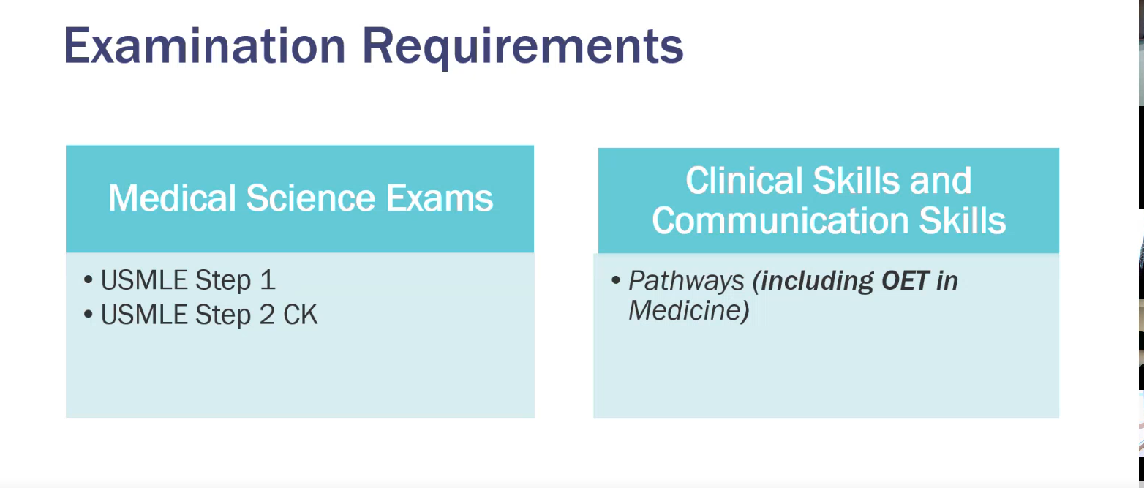

Slide 29
Medical Education Credential Requirements
Medical Education Credentials
Final Medical Diploma
Primary Source Verification
Evaluation of documents
Final Medical School Transcript
Transcript to Document Transfer Credits
Acceptable Degree and Graduation Year
ECFMG Sponsor Note in World Directory of Medical Schools
Communicate directly with medical school
More than 2,000 schools on electronic verification
Evaluation of verification response
Returned from primary source
Completed by authorized official
Reference Guide for Medical Education Credentials
Copyright © 2025 by Intealth. All rights reserved.

Slide 30
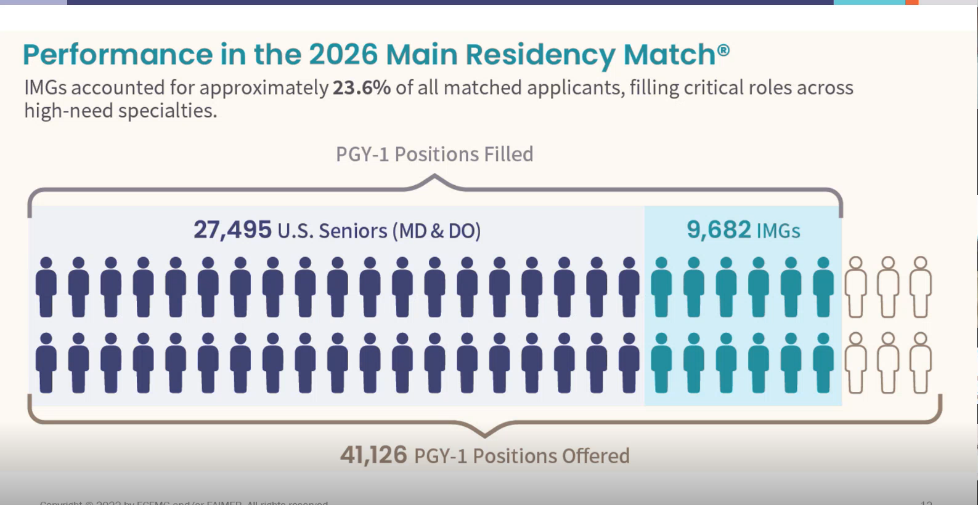

Slide 31

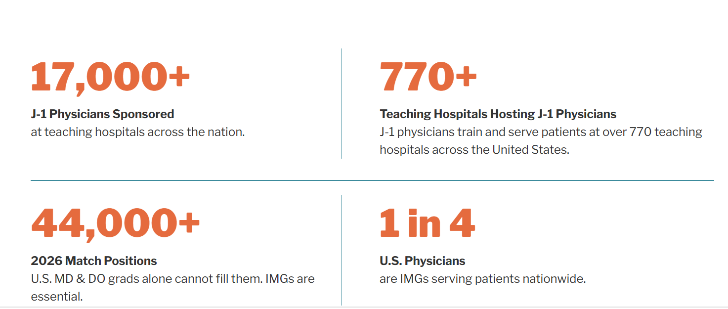

Slide 32

Questions or Comments?
Contact: IMGexperience@intealth.org
Catherine Apaloo
capaloo@intealth.org
Kara Oleyn
koleyn@ecfmg.org
Tracy Wallowicz
twallowicz@intealth.org
Tracy Gill
tgill@ecfmg.org

Slide 33
IMG Success Story
Varsha Songara

Slide 34
Introduction
IMG from India
Residency at Akron general, Akron Ohio
Fulltime hospitalist for 10 years
Part of GME ~ 9 years
APD for past 6 years in rural NC

Slide 35
Our Residency Program
Rural community - university affiliated program
Started in 2016 with FM(4), IM (8), and TY (13)
First graduating class 2019
Tumbled on to accepting J1 visa in 2021
Currently 25% IMG for FM

Slide 36
IMG Success Story
In 2023, SOAP 2/4 spots
Filled with two IMGs
One requiring J1 and other had immigration status

Slide 37
Struggle of one IMG
6 yrs med sch + 3 yrs IM residency + 2 yrs Hospitalist in Moldova
Family immigrated to USA
Worked as MA, office manager, Director of clinical affairs
Prep for USMLE: failure attempt
~ 9 years when applied first for IM residency > didn’t match
Completed 1 yr Geriatric fellowship in NY
~ 10 yrs when applied to FM > didn’t get interview Match > SOAP

Slide 38
Success Story of one IMG
Leadership positions:
  Resident Director - Board of Directors/ NCAFP
  Academic Chief Resident
  Division Council Member, House Representative of the Wakefield Division Council, Montefiore Medical Center, Bronx, NY
Scholarly work:
  Co-authored research and led the publication of 12 articles
  3 book chapters
  15 posters
  2 diploma theses
Awards:
  Resident of the Quarter by health care system
  Resident of the Year
Completed the Lifestyle Medicine fellowship training during residency
Joined us as faculty and Research Director

Slide 39
Our Application Review Process
>600 applications for 80 interview slots for 4 positions
2 reviewers (PD+APD)
1 week time frame
Initial screening for all applicants:
  Geographical preference/ties to the area
  Ongoing clinical experience
  Familiarity with rural community need
  Commitment to serving underserved community

Slide 40
Our Application Review Process
Initial screening for IMG applicants:
  Geographical preference/ties to the area
  Signals
  Ongoing clinical experience in home country/US
  Familiarity with rural community need – volunteering work
  Commitment to serving underserved community – longitudinal local community engagement
  Years since graduation – a loose requirement

Slide 41
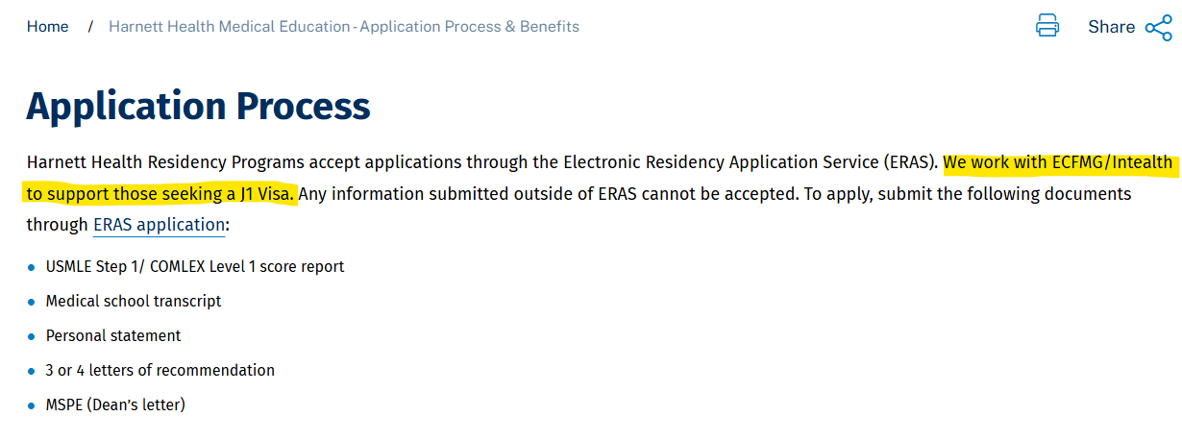
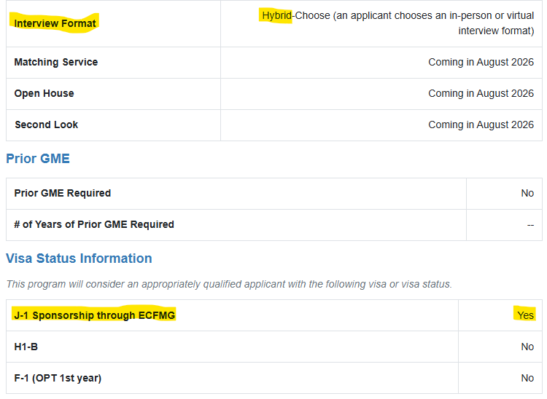
Clear message -Updated website
Notes:
Residency Explorer™ Tool: Program

Slide 42
Thank you
vsong@capefearvalley.com

Slide 43
J-1 Visa Workflow | GME Program Administrator
1. Match/Offer
2. Documents
3. ECFMG
4. Sponsorship
5. Application
6. DS-2019
7. Visa & Travel
8. Orientation
9. Renewal
Identify visa need
Notify PD & GME
Confirm eligibility
Collect passport
Obtain contract
Verify legal name
Confirm certification
Track requirements
Escalate delays
Submit training info
Confirm PGY/salary
Meet deadlines
Monitor status
Resolve deficiencies
Communicate updates
Confirm received
Verify accuracy
Document issuance
Track interview
Monitor approval
Assess delays
Verify arrival
Complete onboarding
Attend orientation
Track expirations
Start 6-8 months early
Maintain compliance
Goal: Right trainee • Right documents • On-time arrival • Continuous compliance
Notes:
Match / Offer Accepted
Identify candidate requires J-1 sponsorship
Notify Program Director and GME Office
Confirm ECFMG eligibility
Document Collection
Collect passport and visa documents
Obtain signed appointment letter
Verify legal name matches passport
ECFMG Certification
Confirm certification status
Track outstanding requirements
Escalate delays to trainee
Sponsorship Submission
Submit appointment information to GME
Confirm PGY level and salary
Meet institutional deadlines
ECFMG Application
Monitor application progress
Resolve document deficiencies
Maintain communication with trainee
DS-2019 Issued
Confirm DS-2019 received
Verify accuracy of dates and information
Document issuance date
Visa Interview & Travel
Track interview scheduling
Monitor approval status
Identify potential arrival delays
Arrival & Orientation
Verify U.S. arrival
Complete HR/GME onboarding
Confirm orientation attendance
Ongoing Monitoring & Renewal
Track DS-2019 expiration
Track passport expiration
Begin renewal process 6-8 months early

Slide 44
Q&A

Slide 45
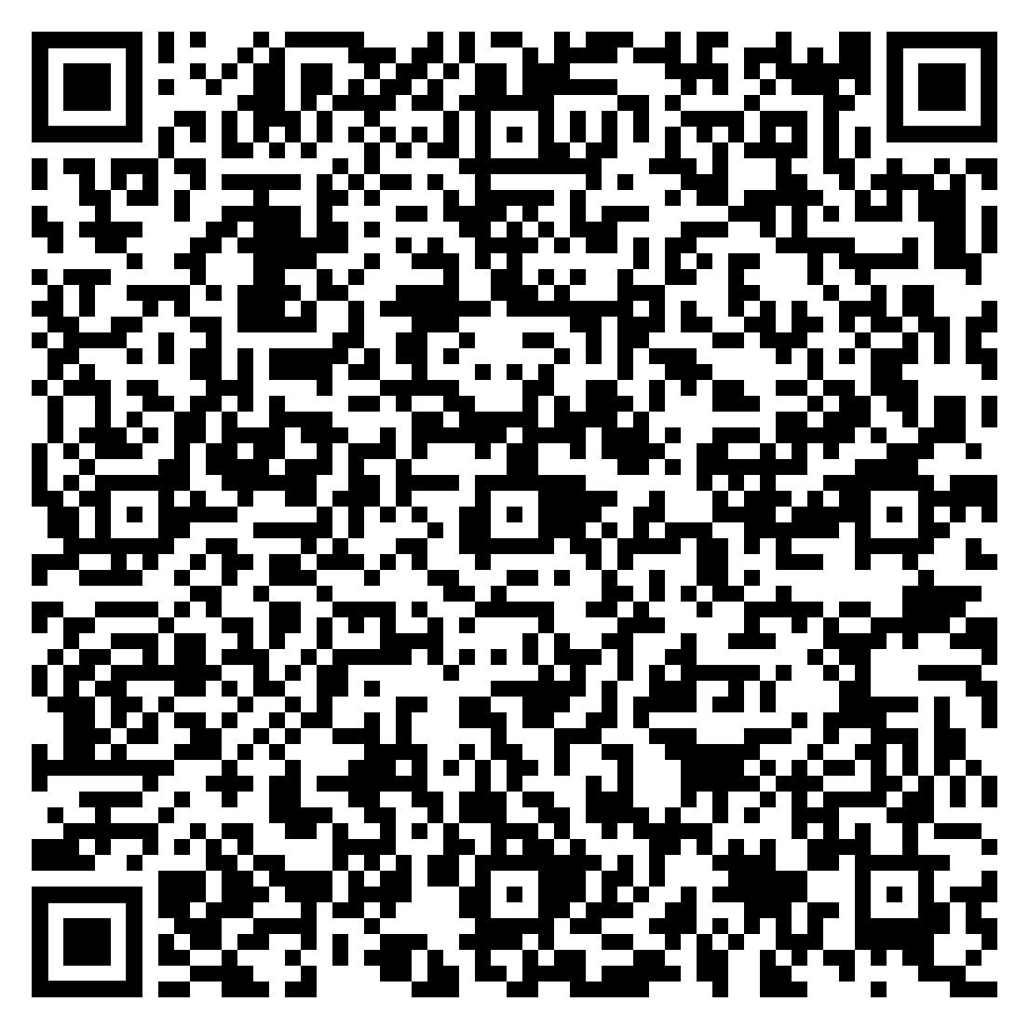
Register for the next webinar:
IMG Transition to Residency
Tues. 9/29 @ 11AM CST

