Slide 1

EPAs as a Tool for Resident Evaluation
AFMRD EPA TASK FORCE

Slide 2
Goals and Objectives
Understand the EPA process of entrustment
Identify settings and methods of evaluation where incorporation of EPAs is helpful.
Describe how EPA language can be integrated into current resident evaluations.

Slide 3
What is an EPA?
A task or responsibility ENTRUSTED to unsupervised execution by a trainee once sufficient specific competence is obtained.
Independently executable, observable, and measurable
Written to describe activities that family physicians will perform when they are in independent practice.

Slide 4
Entrusting the EPA
Scale of Evaluation
  Observation only
  Execution with direct, proactive supervision
  Execution with direct, reactive supervision
  Supervision at a distance and/or post hoc
  Trainee supervises more junior colleagues
ten Cate, O. Nuts and Bolts of Entrustable Professional Activities, JGME March 2013, 157-158

Slide 5
EPA Entrustment is Context Dependent
Trainee Factors:
  Fatigue
  Confidence
  Resident experience
Supervisor:
  Lenient vs strict
  FM vs non-FM
Care Setting:
  Out patient vs hospital
  Night shift vs days
EPA type
  Rarely occur
  Frequent/common
  Complexity
  Global vs specific
Program Setting
  Rural vs urban
  Community vs university
  Large vs small
  Single vs multiple residencies
Notes:
In practice, entrustment decisions are affected by 4 groups of variables: (1) attributes of the trainee (tired, confident, level of training); (2) attributes of the supervisors (eg, lenient or strict); (3) context (eg, time of the day, facilities available); and (4) the nature of the EPA (rare, complex versus common, easy). : ten Cate, O. Nuts and Bolts of Entrustable Professional Activities, Journal of graduate medical education March 2013, 157-158. DOI http://dx/doi.org/10.4300/JGME-D-12-00380.1

Slide 6
Entrustment Decisions in Practice
Ad Hoc Decisions
Structural Decisions
Happening on the fly
  e.g. successful navigation of family conference for dying patient on night shift
Establishing recognition that a trainee may do this activity at a specific level of supervision from now on
Formal acknowledgement of achievement
Notes:
Source 1: ten Cate, O. Nuts and Bolts of Entrustable Professional Activities, Journal of graduate medical education March 2013, 157-158. DOI http://dx/doi.org/10.4300/JGME-D-12-00380.1

Slide 7
Utilizing EPAs for Resident Evaluation
Define care that the residency graduate can be trusted to deliver to the public.
Focus on performance in real-world activities that require specific competencies.
Evaluations containing EPA language are more easily completed and map to specific milestones.
Lend themselves well to final summative evaluation for each resident.

Slide 8
Entrustment Data Sources
Rotation Evaluations
Family Medicine Center 360 Evaluations
Family Medicine Preceptor Evaluations
Resident Patient Panel Data
Chart Review
Direct Observation
Resident Referral Pattern Review
Resident Portfolio
Behaviorist Evaluation of Residents
Procedure Evaluations
Practice Improvement Projects
Video Review of Patient Encounters
Patient Satisfaction Surveys
ABFM In-Training Exam Results
Journal Club or Evidence-Based Answer Presentations

Slide 9
Practical Application
Levels of Entrustment for EPAs (ten Cate) | Miller’s Pyramid (hierarchy of competence)
1. Observation without execution, even with direct supervision | KNOWS
2. Execution with direct, proactive supervision | KNOWS HOW
3. Execution with reactive supervision, i.e. on request and quickly available | SHOWS HOW
4. Supervision at a distance and/or post hoc | DOES
5. Supervision provided by the trainee to more junior colleagues

Slide 10
Practical Application Examples
EPA 5
Utilize language in Patient Satisfaction Survey
Insert EPA language directly into the evaluation
EPA #5 Provide care that speeds recovery from illness and improves function.
Interpretation Graduates of Family Medicine residences will provide care that prioritizes patient centered functional goals and develop a treatment plan that assists the patient to efficiently reach those goals.
Suggested Global Evaluation opportunities: Patient Satisfaction Survey Patient Panel Data Referral Pattern Review
Notes:
Wording can be integrated directly

Slide 11
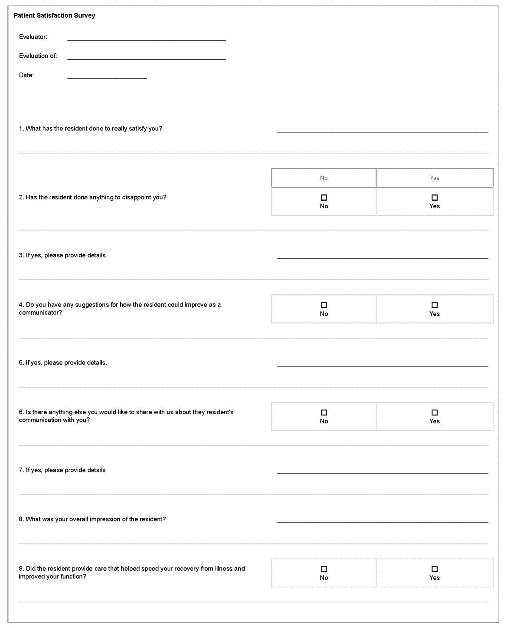
EPA Language in a Patient Satisfaction Survey

Slide 12
Practical Application Examples
EPA 16
Utilize language in Grand Rounds Evaluation
EPA #16 Use data to optimize the care of individuals, families and populations.
Interpretation Graduates of Family Medicine residencies will access, interpret, and apply individual and population-based data using a systematic improvement process to enhance patient-oriented health outcomes.
Suggested Global Evaluation Opportunities: Direct Observation Practice Improvement Project Journal Club or Evidence Based Answers Presentations
Insert EPA language directly into the evaluation
Notes:
Wording can be integrated directly

Slide 13
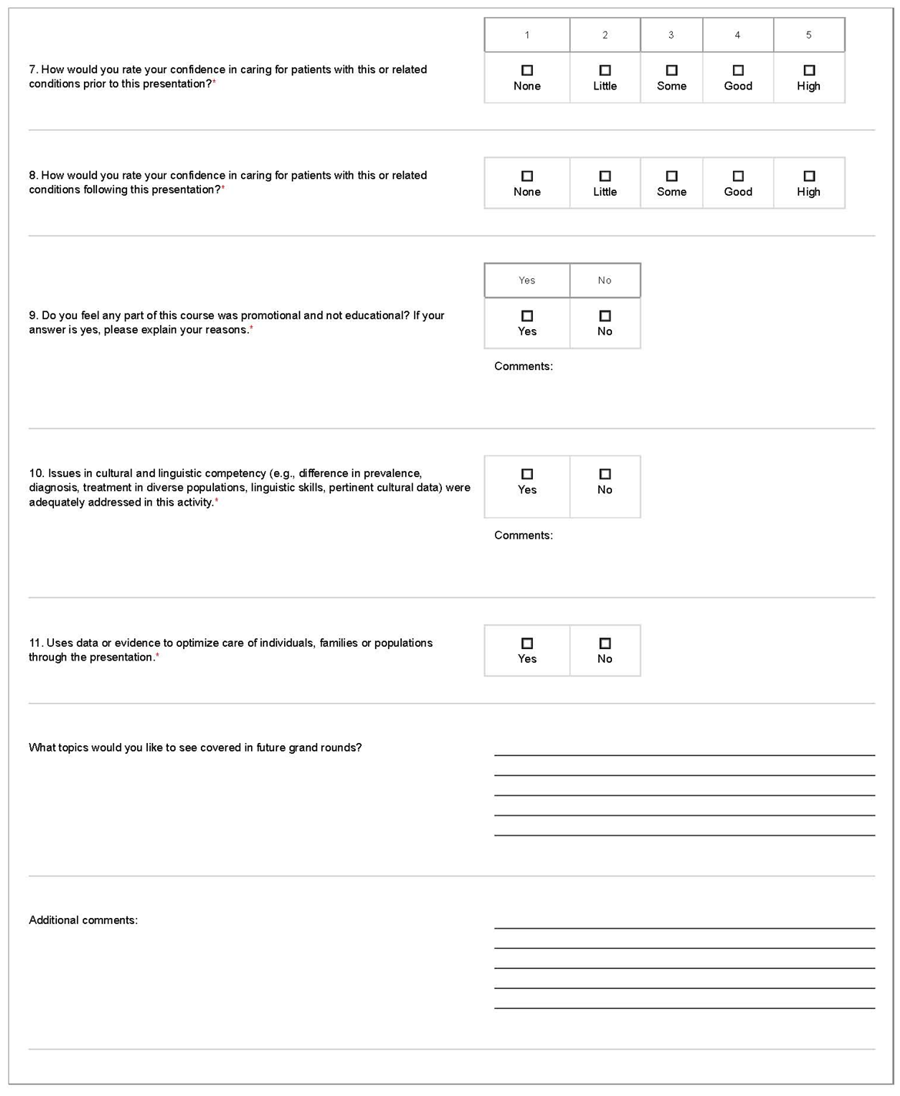
EPA Language in a Grand Rounds Evaluation

Slide 14
Practical Application Examples – Bidirectional Assessment
EPA 3
Reverse Mapping
EPA #3 Provide first-contact access to care for health issues and medical problems.
Interpretation Graduates of Family Medicine residencies will serve as the initial point of contact for individuals and families with undifferentiated health needs seeking to access the health care system. The graduates will be aware of and actively implement strategies to assist the patient to overcome barriers to health care.
Suggested Global Evaluation Opportunities: Rotation Evaluations Family Medicine Center Preceptor Evaluations Direct Observation
Assess current milestones or sub-competencies on current evaluations and reverse map from the evaluation to the EPA.

Slide 15
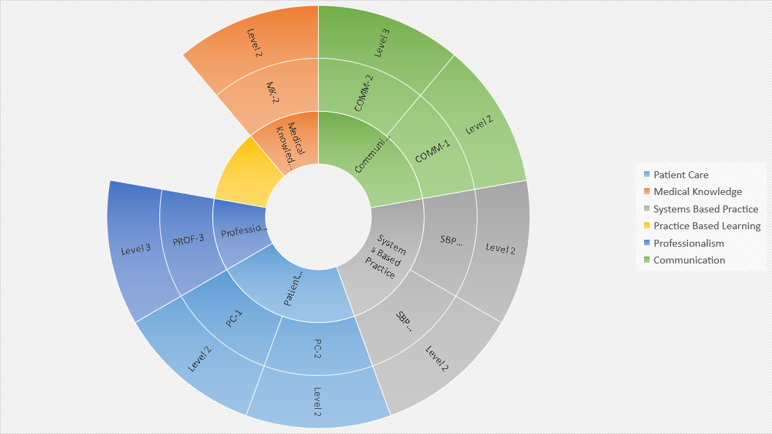
Provide first-contact access to care for health issues and medical problems.
3
Notes:
Middle = EPA
First Ring – Domains of Competency
Second Ring – Subcompetencies
Third Ring – Milestones levels associated with level of entrustment allowing independent practice without oversight

Slide 16
Practical Application Examples:
Non-FM Evaluations
  Problem:
  Addition of subcompetency language to evaluations resulted in decreased completion rates by non-FM faculty.
  Solution
  EPA language is more practical for use by all faculty
  Rewrite the evaluation to include EPA-based questions
  EPA-based responses can be translated into resident milestone rating by the program

Slide 17
Practical Application Examples:
Non-FM Evaluations
  Solution:
    EPA 20 (Coordinate care and evaluate specialty consultation as the condition of the patient requires)
      Cardiology evaluation question: Is the resident capable of recognizing the need for and initiating consultation in the care of a patient experiencing an acute myocardial infarction or non-ST elevation MI?
      If YES, this maps to completion of PC4 level 3, PC5 level 4, SBP1 level 3, SBP4 level 2, and COMM3 level 2.
      If NO, the resident may be operating at a lower subcompetency or milestone level than those identified for independence.

