Slide 1
Family Medicine Advocacy Summit
Robert Wang, MD
SUNY Downstate Medical Center
May 21-22, 2018
Washington, DC

Slide 2
Objectives
What is FMAS?
Why is FMAS important?
My experience
How can you get involved?

Slide 3
What is FMAS?
An opportunity for you to influence current healthcare policy
Learn about legislative priorities in family medicine
Learn how to lobby and advocate on Capitol Hill
Team up with your state delegation (NYS AFP)
Discuss important health policy and issues with members of Congress and their staff
Network with other family medicine physicians and like-minded individuals

Slide 4
Why is FMAS important?
Do you feel passionately about advocating for your patients, colleagues, and community?
You can affect health policy!
This is an opportunity to fight for family medicine on Capitol Hill!
Policymakers listen because you represent their constituents
Gain leadership experience and network

Slide 5
My Experience
I learned how to advocate
I learned about important issues in healthcare and family medicine
I learned how to engage legislators with storytelling
I learned how to maintain relationships with representatives
I learned about best practices for Congressional engagement
I learned how to interact with media
I learned to use data to improve advocacy
I learned about the legislative process
I networked with family medicine physicians, staff, legislators, media

Slide 6
Issues That We Advocated For
Improving maternal mortality
Addressing the opioid crisis
Improving high deductible health plans
Expanding rural GME
Joining the Congressional Primary Care Caucus

Slide 7
AFMRD Scholarship Winners

Slide 8
AFMRD Scholarship Winners

Slide 9
New York Delegation

Slide 10
On the Advocacy Trail!

Slide 11
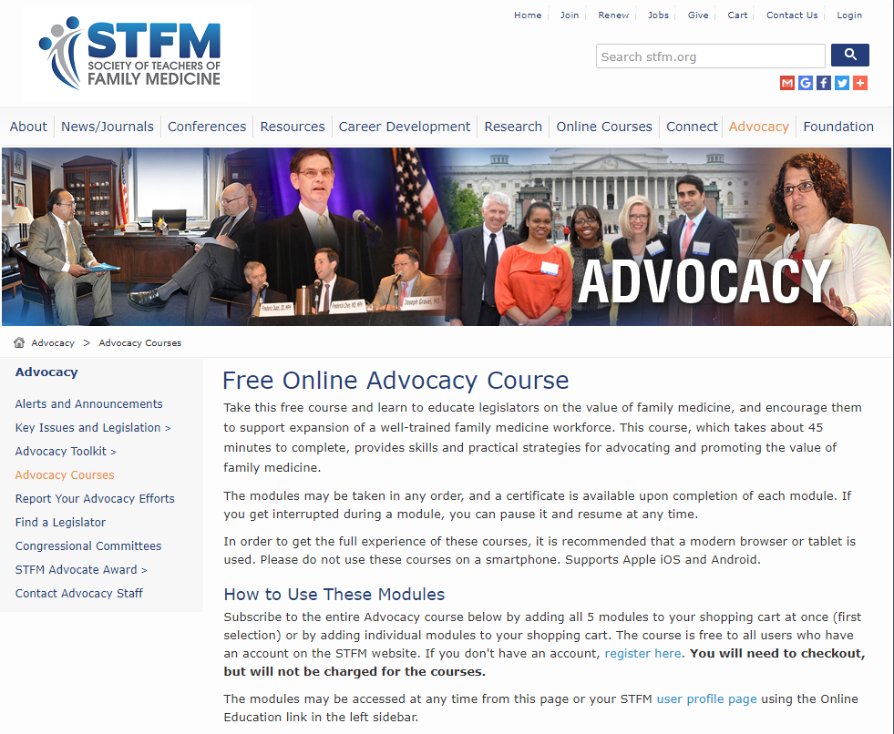
How can you get involved? – Free Online Advocacy Courses
http://www.stfm.org/Advocacy/AdvocacyCourses
Learn how to advocate, how to connect with your legislators, how to prepare for a visit with your legislator, how to interact with your legislator, and how to maintain the relationship

Slide 12
Advocacy Resources
AAFP Advocacy: https://www.aafp.org/advocacy.html
STFM Advocacy: http://www.stfm.org/Advocacy
NYS AFP: http://www.nysafp.org/Member/Governance/Commissions/Advocacy
CAFP: https://www.familydocs.org/advocacy

Slide 13
Scholarships for FMAS
AFMRD: http://www.afmrd.org/page/resident-scholarship
AAFP: https://www.aafp.org/dam/AAFP/documents/events/fmcc/SummitScholarshipApp.pdf
STFM: http://www.stfm.org/Conferences/FamilyMedicineCongressionalConference/NewFacultyAdvocacyScholarship

Slide 14
Thank you!

