Slide 1
Family Medicine Physicians as Advocates
Megan Scott MD PGY2
Notes:
I was a scholarship recipient through the AFMRD (Association of Family Medicine Residency Directors) for the Family Medicine Advocacy Summit in Washington D.C. in May. As part of the scholarship, we are encouraged to come back to our programs and communities and share information about physicians as advocates and our experiences lobbying for policy change. I want to talk a bit about the process of lobbying and how physicians can make an impact by sharing their stories and experiences as we advocate for our patients and profession.

Slide 2
Goals of Advocacy:
Inform, engage and listen
Propose solutions to legislators
Long term goal- have your cause supported by legislators to change policy.
Short term- Engage your legislator or staffer to develop relationships and be a resource to them.

Slide 3
STFM (Society of Teachers of Family Medicine)
Free online advocacy course at:
http://www.stfm.org/Advocacy/AdvocacyCourses
Notes:
STFM had a free online advocacy that takes you through the “how to’s” of advocacy. This included issues I will briefly cover including goals of advocacy, roles of staffers vs legislators, establishing relationships with legislators, addressing specific bills or “asks”, developing a one pager, setting up a meeting with legislators, and following up to continue relationships.

Slide 4
Where can you advocate?
From STFM Advocacy Course : Module 1

Slide 5
Crash Review on US Gov’t:
Notes:
If you are like me and A.P. Gov in high school is a distant memory, you may need a crash review of the roles of state vs. federal government.

Slide 6
Federal Government
Notes:
The federal government is comprised of these three branches. The legislative branch – AKA Congress- is divided into the senate and the house. There are two senators from each state and 435 representative which are allocated based on population. Texas has 36 representatives. Congress is responsible for making laws, approving federal judges and justices, passing the national budget, and declaring war. Next we have the executive branch led by the president and vice president. They enforce laws of congress, work with cabinet, appoint government officials, command the armed forces, meet with international leaders and this branch is comprised of about 4 million people. Finally we have the judicial branch which includes federal, district and the Supreme Court. They interpret laws and punish those who break them.

Slide 7
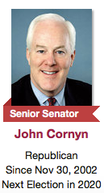
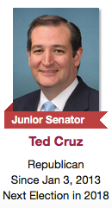
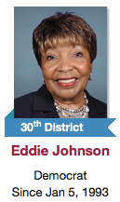
U.S. Congress Members for Texas
Texas Senators
Representatives (there are 36)
Notes:
Each state elects senators for staggered 6 year terms. Our Texas Senators are John Cornyn and Ted Cruz. There are 36 Texas Representatives based on districts. Our Representative for the district the clinic is in is Eddie Bernice Johnson.

Slide 8
Passing legislation:
Notes:
Bills can originate in the house of the senate. For example, a representative first sponsors a bill, then it is assigned to committee for study. If the committee releases it, it can be debated, amended, or put to simple vote. If it passes by a majority, it goes to the senate. Then it goes to senate committee to be amended, debated, and released to vote. If it passes senate by simple majority, it goes to the conference committee of House and Senate members to work out any differences before returning to each chamber for final approval. Finally, the Government printing office prints the bill and the president has 10 days to sign or veto.

Slide 9
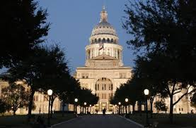
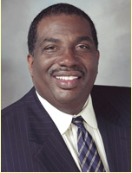
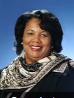
Texas State Government: Also has a legislative, executive, and judicial branches
Texas State Senate:
31 Seats
Our Senator for the hospital’s district is:
Royce West (D) Dist. 23
Texas State House of Reps:
150 members
Our Rep for the hospital’s district is:
Yvonne Davis (D) Dist. 111
Notes:
The Texas state Capitol is in Austin. Texas constitution declares that regular session be held on 2nd Tuesday of January of each odd numbered year at noon and run for 140 calendar days. The Legislative branch is divided into a Bicameral system (two chambers, senate and house). Our State Senator for the hospital district is Democrat Royce West and our Representative is Democrat Yvonne Davis. The executive branch is comprised of elected officials like the governor (ours is Republican Greg Abbott), The Judicial branch is comprised of all the courts including municipal, county, Texas Supreme Court, etc.

Slide 10
Prepare for your meeting: Research your legislators
What is their stance on current issues?
Do they have a staffer who conducts their meetings?
How have they voted on this issue in the past?
How are you planning on contacting them?
Visiting
Calling
Letter or Email
Notes:
It’s important to know that your opinion and your contact with your legislator does carry weight- particularly as a physician. These offices keep large amounts of data on calls, emails, and visits and staffers may be asked by the legislator how many calls/visits for or against an issue they have received.

Slide 11
Identify your “Ask”
What is the issue that matters to you and your audience?
What is the solution to your problem and what specifically are you asking them to do?
This may including asking them to cosponsor legislation, join a caucus, or support a bill.
Notes:
You want to be able to understand what the legislator can feasibly do and ask them what you want them to do to help. Your ask needs to be specific and you need to convey why it matters- which will occur in the one pager and the story. For example, you might say, “Senator Cruz, I am asking you to support ACE Research Act which is part of Senate bill 2406. Let me tell you why we need more research on expanding chronic pain research…”

Slide 12
Make a one-pager:
Provides concise and clear summary of an issue
May help the legislator (or staffer) understand the scope of the issue
Includes your “ask”, background information, and supporting data
Helps organize the visit and keep you on task as you advocate
What is the problem and why should they care?
Notes:
I will show you an example later on in my presentation of a one pager we used for the FMAS. The staffers were pleased to get these and even made notes or asked questions about information on the one-pager.

Slide 13
Craft your “story”:
Convey what we see in our practice and why it matters.
How does this issue affect real people and physicians?
Give an example of the “character”, goal, adversity, and resolution
You may need to have several versions of the same story depending on the amount of time (30 sec, 3 min, etc)
Notes:
This is the most compelling way to convey why this issue matters and why they should care. The staffer and legislator may not remember your facts and data, but they will remember the personal stories. For example, when lobbying for increasing research on opioids and chronic pain management, one of the Texas physicians I lobbied with told stories about a prominent high school principal in his community who became addicted to opioids after having a kidney stone and an Eagle Scout in the community who overdosed.

Slide 14
Meet with your legislator (or staffer)!
You will likely have a 15 minute encounter (but it may be even shorter!)
Plan to tell your story and your “ask”
Offer personal assistance as a resource, answer any questions they have
Plan to send a follow up email answering any questions and thanking the staffer or legislator for their time
Notes:
You will have to have set up a visit with the legislator or staffer. If planning to visit in person, call ahead and ask for the staffer handling health care issues.

Slide 15
What were the AAFP “asks”?
Senate
House
Support ACE research ACT (S. 2406)
Sign on as a co-sponsor to Rural Physician Workforce Production Act of 1028
Cosponsor Maternal Health Accountability Act (S. 1112)
Cosponsor Primary Care Patient Protection Act of 2018 (HR 5858)
Cosponsor ACE Research Act (HR 5002) and CONNECTIONS Act (HR 5812)
Cosponsor Preventing Maternal Deaths Act (HR 1318)
Join Congressional Primary Care Caucus

Slide 16
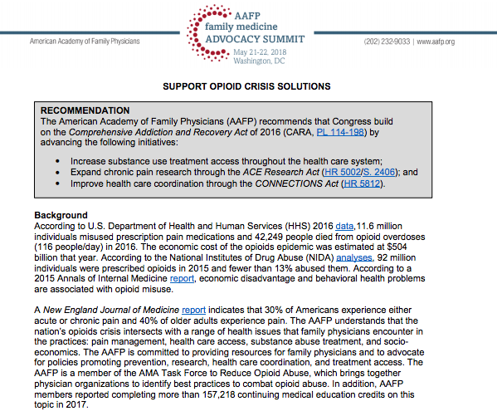
Notes:
Here is an example of a one-pager we used for the FMAS when lobbying for opioid crisis solutions

Slide 17
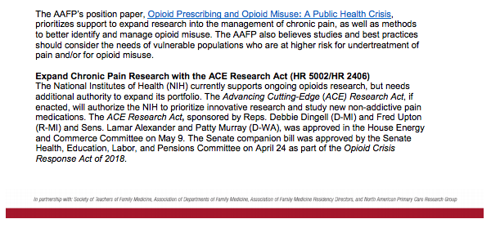

Slide 18
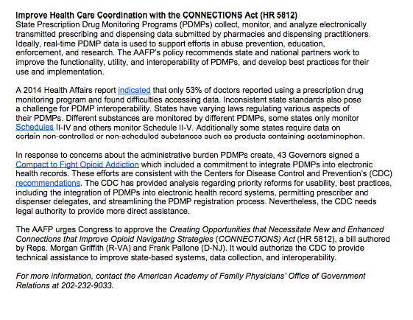
Notes:
Example of a one-pager from FMAS

Slide 19
Why advocate for primary care in Texas?
20.2% of Texans live in a health professional shortage are
Family Medicine contributes $15 billion in direct and indirect economic output in Texas
There will be an estimated additional 6,260 physicians needed by 2030
Family Medicine contributes 92,234 jobs directly and indirectly to the work force
Notes:
According to AAFP in May 2018

Slide 20
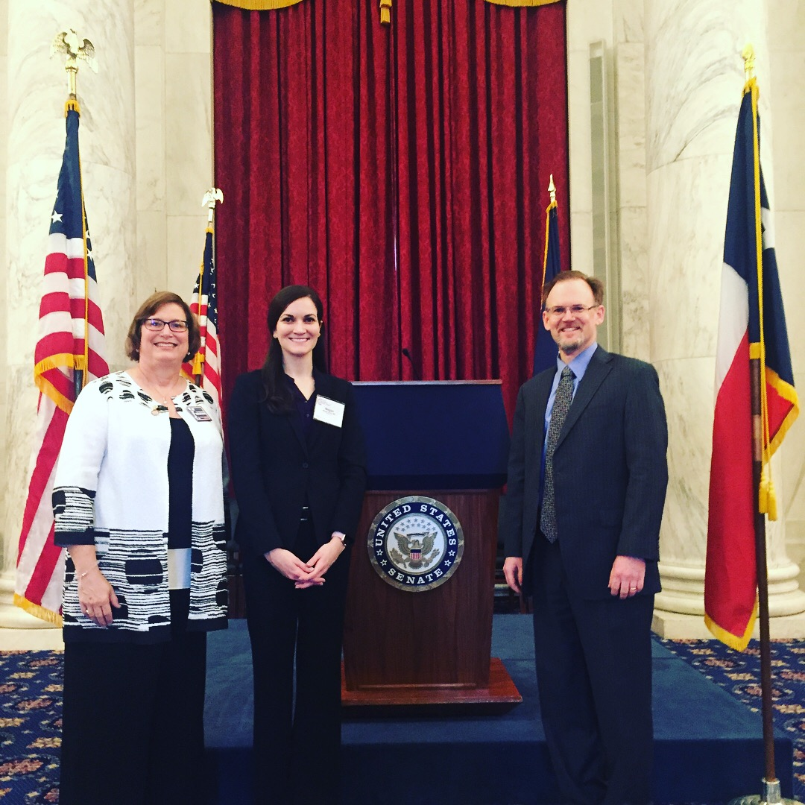
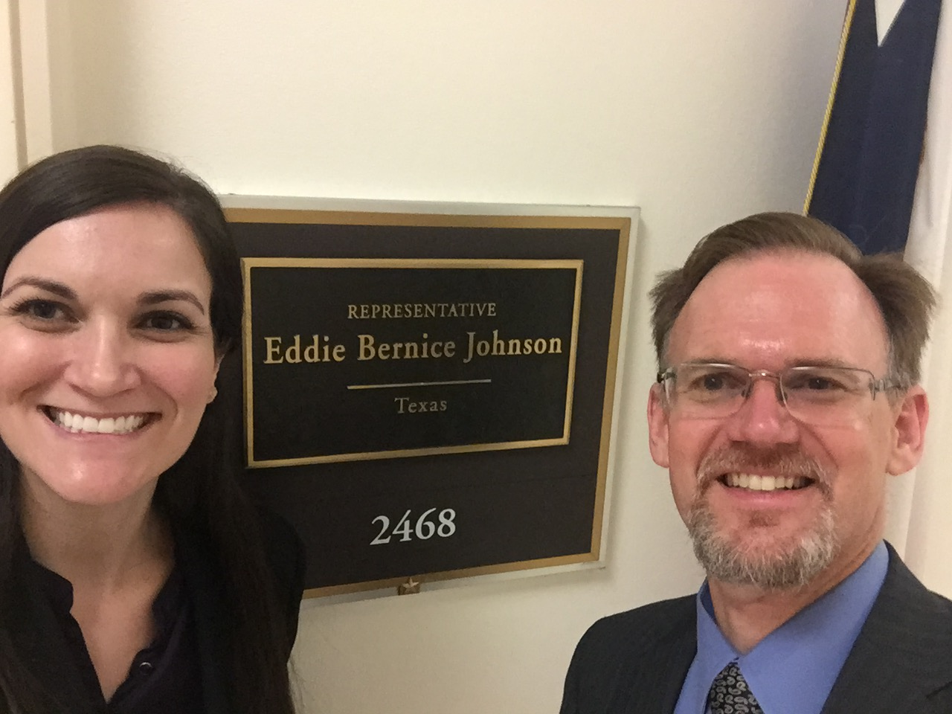
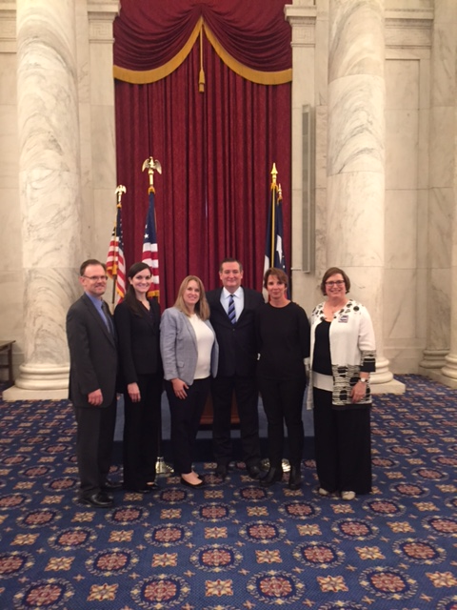
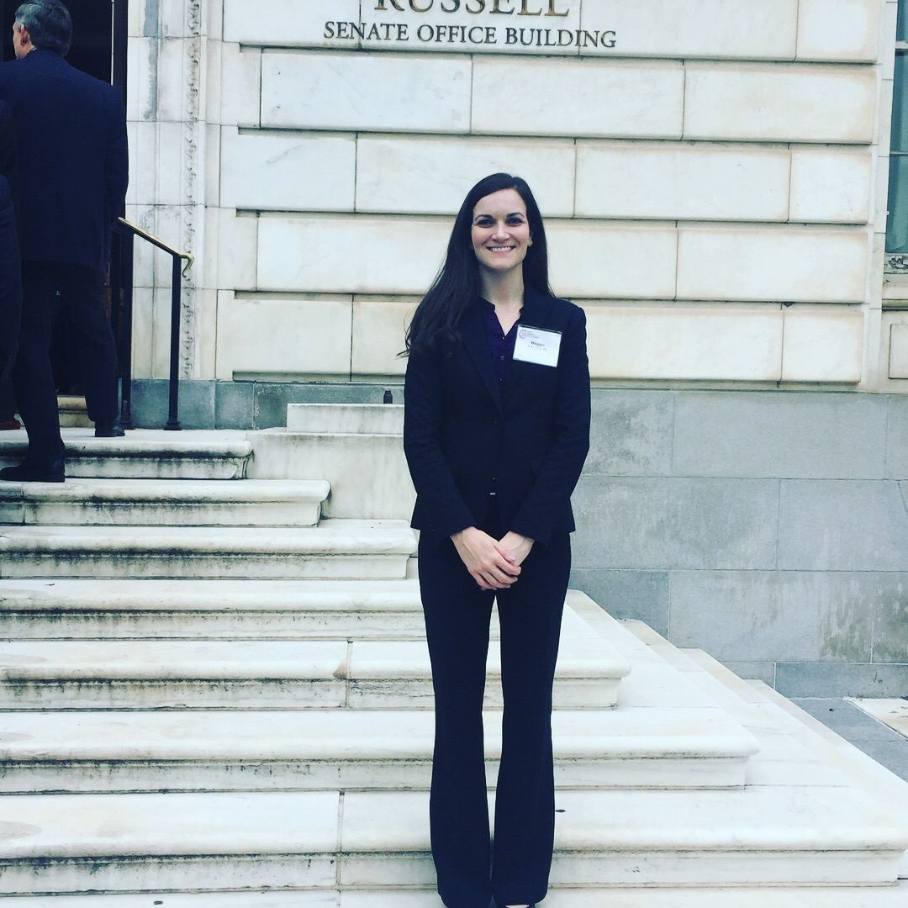
Pictures from my visit to D.C.:
Notes:
Here I will share some of my personal experiences with visiting D.C. and lobbying with other Texas family medicine physicians.

Slide 21
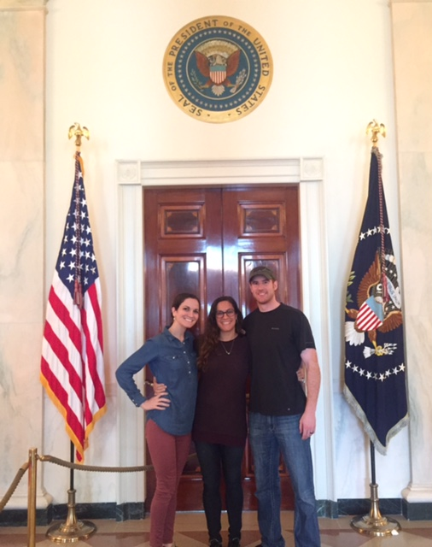
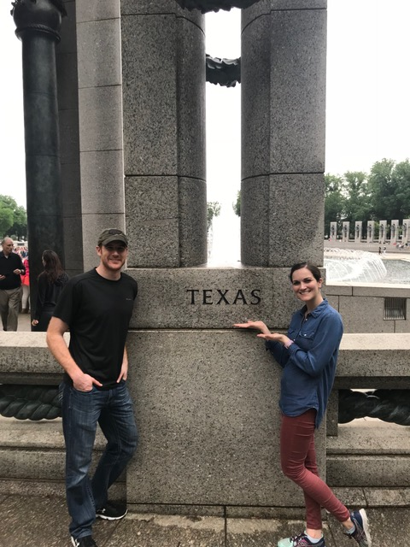
Just a few more

Slide 22
References:
STFM, Free Online Advocacy Course, Accessed online 5/2/18, http://www.stfm.org/Advocacy/AdvocacyCourses
AAFP, Family Medicine Advocacy Summit, Leave- Behind Support Opioid Crisis Solutions, accessed 5/31/18 https://www.aafp.org/dam/AAFP/documents/events/fmas/BKG-SupportOpioidCrisisSolutions.pdf
AAFP, The Importance of Family Medicine in Texas, distributed at FMAS 2018 by AAFP
AAFP Resources for Policymakers. Retrieved from http://www.aafp/org/advocacy/act.policy_resources.html

