Slide 1
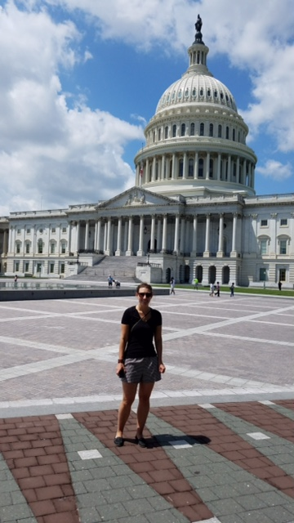
AAFP Family Medicine Advocacy Summit
May 21-22, 2018
#FMAS2018

Slide 2
What is all the fuss about?
Travel to Washington DC
Meet with out state representatives and talk about health care
Have your voice heard!
Meet other politically active Family Medicine peers
Sight seeing of our capital
Notes:
This was a great way to feel like my voice matters, meeting and discussing current issues in health care. I had the opportunity to meet many other motivated individuals from all over the coutnry to discuss change sin health care

Slide 3
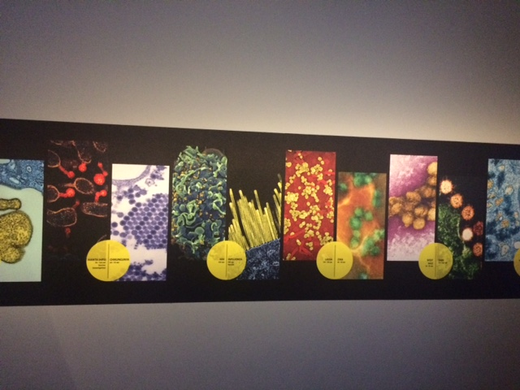
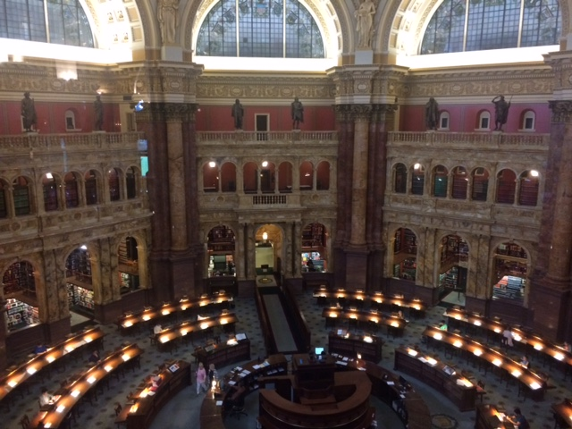
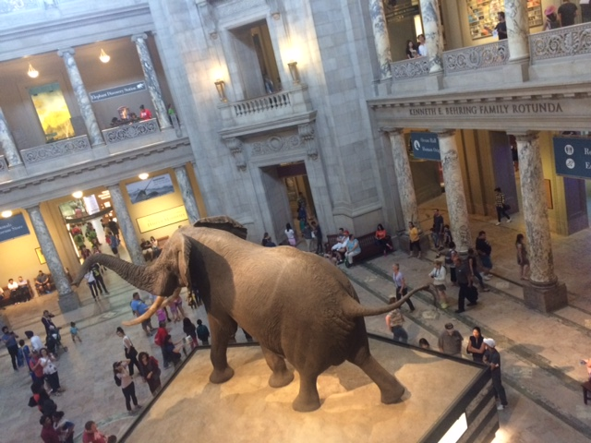
A little fun in the City
Notes:
We got the opportunity to do a little bit of sight seeing

Slide 4
How to get involved
AAFP advocacy scholarship
AFMRD scholarship winner
$150 + room and board to go as a resident
Notes:
I applied to a scholarship through the AFMRD and was one of 12 residents chosen across the United states to go to the conference. There were many other residents there involved in their states Advocacy.

Slide 5
Scholarship Winners

Slide 6
Why get involved
Have a voice to bring change to medicine
Meet your state representatives
Meet other advocates for Family Medicine
Notes:
This was a great opportunity to meet other family medicine residents and physicians form all over the united states who were enthused about family medicine and advancing our profession and advocating for our patients

Slide 7
Notes:
The importance of being a Maine physician- discuss sheet

Slide 8
Day #1
Learn how to talk to your state representatives
Discuss the bills the AAFP is urging representatives to pass/ support
Discuss upcoming changes in primary care
Strategize a plan to talk to state representatives
Notes:
The first day of the conference we were able to discuss the bills and strategies a plan to discuss them with our state representatives. We also got to know the other members from our state delegation.

Slide 9
Maine State Delegation

Slide 10
Notes:
Hand out copies of complete Bills to residents

Slide 13
At the end of the day
My voice matters
Have a new appreciation and understanding behind our legislature
Invigorated by the changes happening in Family Medicine
Excited for the future of Family Medicine
Notes:
After the conference I felt excited and eager to be involved in change in the family medicine. I was proud of the work we are doing and look forward to being involved in more change in the future.

