Slide 1
Advocacy in Family Medicine
Kirsten Gierach, DO
June 13, 2016

Slide 2
Outline
Advocacy 101 in Clinical Context
FMAS overview
What is advocacy
Why should family medicine docs advocate?
How might you find yourself in a position of advocating?
Overview of a controversial topic
Basic Steps of advocating
Other ways to advocate
Notes:
Some of you know I had the opportunity to go to Washington DC and participate in a day of advocating for issues important in FP. This is not anything I every thought I would get into, but since starting residency I’ve been exposed to it through WAFP and Doctors day, and I do think it’s something that we all can and should be involved in. One of the goals of this presentation is to tell you why and how easy it can be. We’ll also walk through a clinical case that I think you’ll find interesting and also see how you could find yourself in a position to advocate.

Slide 3
Family Medicine Advocacy Summit
Annual event
Washington, D.C.
FPs, residents, students from around the US
2 day event
Day 1 Debriefing and Meetings
Day 2 Advocacy on the Hill
Notes:
2 day event event held in D.C. FPs from around the US meet with the goal of having a positive influence on Congress. The first day we met to learn about the issues that affect family medicine at the federal level and focus on a few key issues, learn about the legislative process, and how we can influence decisions. The next day we put what we learn into practice. This years topics centered on AHCA, funding for residency teaching centers, and we also asked for participation in the Primary Care Caucus.

Slide 4
11 delegates from Wisconsin
Met with 2 senators and 4 representatives
Senators Tammy Baldwin and Ron Johnson
Reps: Mike Gallagher, Glen Grothman, Paul Ryan, Mark Pocan
Notes:
A lot of the time you do meet with staff rather then the reps,

Slide 5
Advocacy
“a person who publicly supports or recommends a particular cause or policy”
Notes:
Let’s start with a definition. One thing that sets an advocate apart is the word “publicly”. And this can be the part that is intimating to people and may defer them from trying.
But we as family physicians advocate for our patient’s everyday! Think through a typical clinic day. With specialists, insurance companies, work, disability. Advocating with law makers is just another area we can do this in. Let’s be clear, this is NOT a US government class and I am not going to be reviewing the legislative process. My objective in this, is to help you see that being an advocate can be easy, and rewarding, and hopefully inspire you to be advocates in new ways.

Slide 6
Why?
Family medicine physicians are in a position to be health advocates!
We follow closely with patients (we know what issues effect them)
We are cost effective so they should listen to us! Continuity of care translates into lower costs and better outcomes (Starfield research)
Legislators need our help and expertise (not all are health experts)
Notes:
One of the things that has really struck me with being involved in advocacy with other FPs, is how unique our position is when it comes to advocating that sets us apart from other specialties.
-Because of the continuity we have with patients, we are better able to explain how laws effect them and give strong stories
-We see a diverse population for multiple complaints, any healthcare laws will effect our patients.
-They should listen to us and support our recommendations because we are cost effective!
-Starfield’s research in 2005 showed that county’s with higher proportion of FPs had better outcomes and lower mortality. This fact was mentioned often when talking to legislators and they seem to respond to this notion. Starfield was a very influenential researcher in the realm of advancing primary care.
-Not all legislators are experts in medicine and do need and often appreciate our insight and guidance into topics.

Slide 7
Case
How might this come up in a normal clinic day??
Notes:
So to try and put this into clinical perspective, we are going to walk through a case scenario. (this is a true patient case)

Slide 8
27 year old male
New patient to Mosaic
CC: Migraine headaches
History: ongoing since he was 7, almost daily at times. Has tried multiple abortive therapies and prophylactic agents but seems to build a tolerance.
Has had FMLA previously for this
Only thing that has worked in the past is smoking marijuana but he stopped this
He asks….”What about CBD oil? Didn’t Walker just legalize it? Do you think you could prescribe this for me?”

Slide 9
What are your reactions to this question??
Notes:
Do you have any knee jerk reactions? What would you say?
-This is actually a patient I saw, and to be honest I was pretty unfamiliar with CBD oil other then the controversy in the news, and use in pediatric seizures
-blow him off? Tell him it’s not safe?

Slide 10
What do you need to know?
What is CBD oil? How is it different then marijuana
Why the political controversy?
How is it used?
Is it legal in Wisconsin?
What are the known risks/benefits?
Research??
Would my patient benefit from it?
Notes:
If you are like me, I had a gross lack of knowledge. These were some of the questions I had and can hopefully answer with the rest of this presentation

Slide 11
CBD
Cannabidiol
One of the active ingredients in cannabis, different then THC
No psychoactive effects
Low affinity to the CB1 and CB2 receptors
Enhances 5-HT, Glycine receptors, G couple receptors, effects intracellular calcium, antioxidant effects, anti-inflammatory effects, analgesic
“Charlotte's Web”
Orphan Drug status for treatment resistant childhood seizures
Notes:
Cannabidiol is not to be confused with THC, while both come from cannabis, THC is most active ingredient. Cannabidiol has no psychoactive effect, marijuana has high levels of THC
CB1: mostly in the brain, CB2 common in the immune system. CBD does not directly interact with these
Thought to have a major anti-inflammatory, analgesic, anti-nausea, anxiolytic, anti-epileptic. These have been the focus of research and possible clinical use.
Charlotte’s Web is marketed as a dietary supplement, produced in Colorado, high CBD to THC

Slide 12
Notes:
Just in case any one wanted a chemistry lesson, this is all you get.
Remember that THC and CBD are different

Slide 13
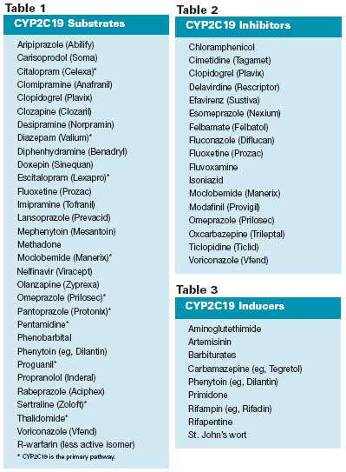
CBD Pharmacokinetics
Overall, not well known
First pass mechanics
Absorption depends on route (IV, oral, inhaled)
½ life of 9-32 hours
Low toxicity profile in studies (short term use)
Inhibitor of CYP450 (drug-drug interactions)
Pharmacytimes.com
Notes:
So far research has not shown any adverse effects, but most studies are limited on length. Most studies are anecdotal, case reports, preclinical studies
Should remember that it is an inhibitor of CYP450

Slide 14
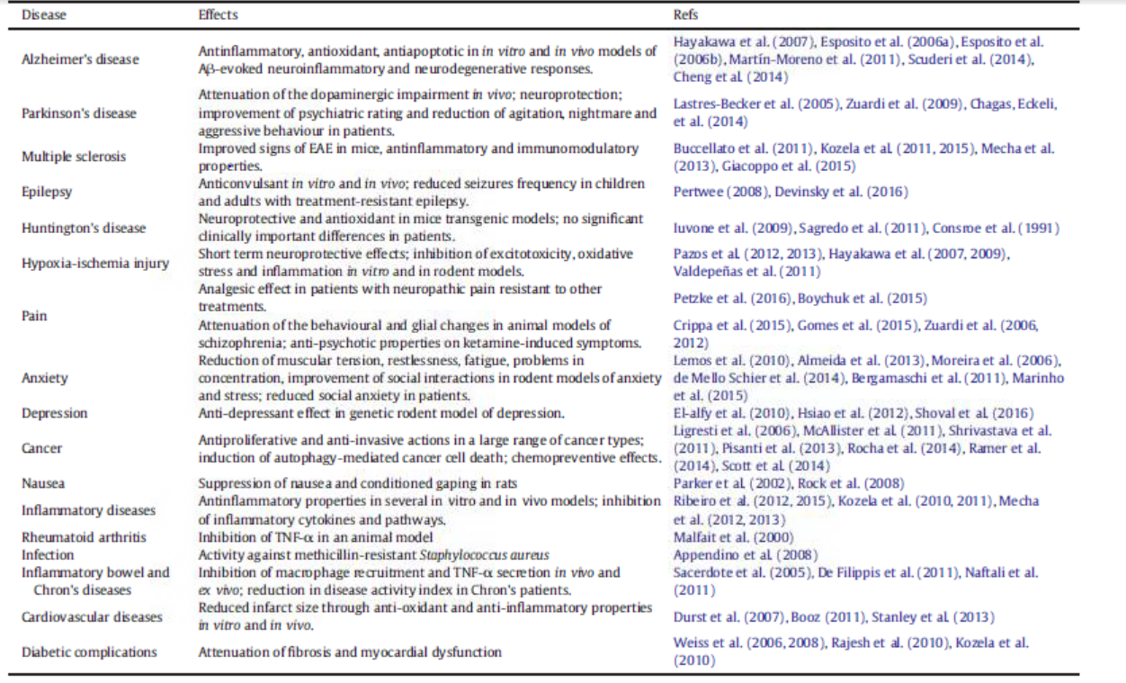
Proposed Uses (5)
Notes:
Going through multiple sources, these are some of the proposed uses for cannibidiol based on theoretical models and in vitro/vivo studies. We will be going through some research on this later. This had lead researches to theorize application toward inflammatory conditions and pain.

Slide 15
Possible Adverse Effects (2)
Sedative
Psychological
Perception
Motor function
Dependence (9%)
Withdrawals
Stroke
Cerebral blood flow changes
Tachycardia, arrhythmia, MI
Carcinogens
Slowing of GI system
Reproduction
Notes:
These are the adverse effects related to THC heavy products, when it comes to CBD the adverse effects are not as well characterized. Also much of what we know about side effects are from studies and case reports evaluating recreational users.
Psychological: euphoria, psychosis
Perception: distortion of sense of time, space, hallucinations
Motor function: ataxia, weakness, disequilibrium,
Dependence: with heavy use, (tobacoo is 32%)
Cerebral blood flow: increased with acute cannabis use, decreased with chronic use. Loose associations with stroke
Tachycardia with acute use and possible increase risk of with acute use.
Cannabis smoke may contain more harmful cytotoxic and mutagenic condensates. No studies have linked it with cancer
Suppresses ovulation and sperm counts

Slide 16
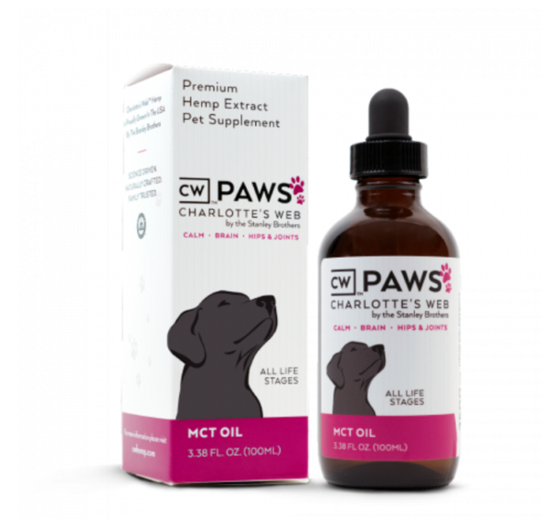
Where do people get CBD?
Notes:
You can find anything online…

Slide 17
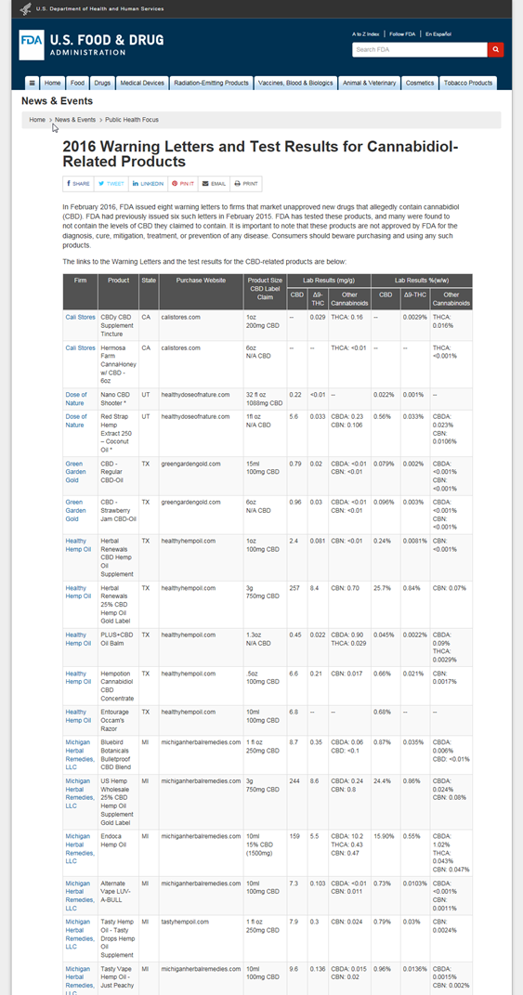
Notes:
Because CBD is not FDA regulated, there is no standard preparations. However, the FDA has tested certain products and put warnings letters out.

Slide 18
So Why all the Controversy?
Notes:
From this search, it seems like there should be a big deal about CBD. To get a better understanding, we need to take a look back.

Slide 19
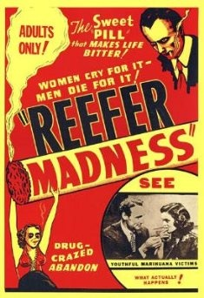
Historical Context: Cannibinol
Medical use dates as far back as 1400-2000 BC
1611: brought to Jamestown by settlers
1850: listed in US Pharmacopeia
1913: US Dept of Ag grows domestic cannabis
1915 Sir William Osler, advocated for cannabis use in migraine
1930s: William Randolph Hearst plays role in denouncing marijuana
1936: “Reefer Madness”
Marijuana Tax Act of 1937
1960s: THC identified and synthesized, U of Mississippi becomes official grower under the Feds
1970: Made a Schedule I substance, “No accepted Medical Use”
1976: Federal Court Rules Robert Randall’s Use of THC “Medical Necessity”
1978:-1991 Compassionate Use Program supplies patients with THC
1996: California becomes first state to legalize medical THC
Notes:
A brief history lesson. Could really spend all day on this
Sanskrit and Hindi lit
1850: listed marijuana as treatment for numerous afflictions, including: neuralgia, tetanus, typhus, cholera, rabies, dysentery, alcoholism, opiate addiction, anthrax, leprosy, incontinence, gout, convulsive disorders, tonsillitis, insanity, excessive menstrual bleeding, and uterine bleeding, among others
Started growing in early 1900s, before that imported from India
In the early 1900s, US government started putting negative connotations to THC and linking it to criminal behavior, many think this was because the production of hemp was taking off and competing with lumbar/paper industries
Cult classic, intended to be a cautionary tale
1937:Negative propaganda from US around THC labeling it as a drug of abuse. Some think this was due to growing hemp industry. Marijuana Act was against the AMA’s position. Added high taxes and penalties
Same as LSD and heroine, more so because of lack of scientific evidence of benefits and risks, government concerned of growing marijuana economy
Research on Marijuana has remained illegal because of this. NIDA does contract with University of Mississippi– research-grade cannabis
There have been multiple attempts to have the DEA reschedule cannibus, but so far have not been successful.
http://medicalmarijuana.procon.org/view.timeline.php?timelineID=000026

Slide 20
Notes:
California was first to legalize medical marijuana in 1996, since then 28 states of legalized medical marijuana .
Limited Marijuana includes CBD and those low in THC
In states were medical marijuana is legal, physicians don’t actually prescribe, rather they write a letter saying it is medical treatment

Slide 21
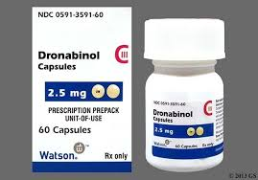
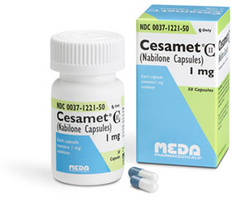
Currently 2 forms of synthetic THC is FDA approved in the US
Dronabilon (Marinol): cancer related nausea and vomiting, anorexia/weight loss in AIDS pts
C-III, 10 mg (60) $1351.30
Nabilone (Cesamet): cancer related nausea and vomiting
C-II, 1mg (50) $2252.05
Notes:
We do have 2 forms of synthetic marijuana. Which his interesting that the FDA approves when the federal govenerment has claimed that there are no medical uses of marijuana

Slide 22
What’s going on in WI?
2014 Lydia’s Law: CBD legalized*
4/17/17: Walker signed Act 4 which expands use of medical cannabis law (Lydia’s Law)
Notes:
*Clause added caveat that to be legal must have FDA approval
Walker approved expansion on previous cannabis law, allows patients to possess CBD with a physicians letter. However, still illegal to produce or distribute CBD products in Wisconsin so patients have to get it in other states
http://fox6now.com/2017/01/17/wisconsin-democrats-propose-legalizing-medical-marijuana/
https://www.mpp.org/states/wisconsin/

Slide 23
Current Research
Barriers to research on THC due to Category I
Lack of high quality studies
Lack of long term follow-up
Anecdotal stories

Slide 24
Mix of Experimental and Clinical research
Cannabinoids suppress inflammatory and neuropathic pain by targeting α3glycine receptors. Journal of Experimental Medicine (13)
Short-Term Efficacy of CBD-Enriched Hemp Oil in Girls with Dysautonomic Syndrome after HPV (9)
Notes:
Earlier I mentioned some to the proposed used of CBD and cannibus. When you start looking the individual studies there is a mix of in vivo animal studies and also some strange cases…
Mice/rat model. CBD could be used to potentiate pain. Interesting
Completed in Italy, tolerated but no really no effects. Started with 21 females with severe somatoform/dysautonomic syndromes after HPV vaccine. 2 dropped out due to “iatrogenic adverse events, 2 stopped due to lack of improvement.

Slide 25
Cochrane Searches on CBD
Study | Type | Conclusions
Cannabinoids for Epilepsy 2014 (6) | Meta-analysis -4 RCTs | No reliable conclusions regarding efficacy, but no adverse effects reported for CBD in the short period
Cannabis and schizophrenia 2014 (9) | Meta-analysis -8 RCTs | Results limited and inconclusive. Insufficient to show that CBD has anti-psychotic effect
Cannabinoids for the treatment of dementia 2009 (7) | Meta-analysis - 1 RCTs met inclusion criteria | No evidence that CBD is effective More research needed
Effectiveness of cannabinoids in non cancer chronic pain (2) | Meta-analysis -13 RTCs | May provide analgesia in chronic neuropathic pain conditions refractory to other tx
Notes:
Was able to find some systemic reviews, however many of the studies do lump CBD with cannibus.
Assess efficacy and safety. One report was an abstract, one a letter to the editor. Low quality reports
23% of people with schizophrenia use cannabis. This review had 3 objectives
assess effects of psychological tx for cannabis reduction
Assess effects of of antipsychotics for cannabis reduction
Assess effects of CBD for symptom reduction
Looked at primary outcomes of clinical global impression of change and cognitive function. Had poorly presented results could not draw conclusions
Studies differed in type of cannabinoid used, time frame was 1-6 weeks. Side effects were greater in studies with smoked cannabis (sedation, anxiety, confusion, dizziness, concentration issues, decreased salivation and increased thirst. Gave a number needed to treat of 2-4 for 9 studies.

Slide 26
Notes:
Review of current research on CBD in epilepsy and neuropsychiatric medicine
Overall, CBD is promising as an anticonvulsant in acute animal models, but chronic is lacking
Does have neuroprotective and anti-inflammatory effects
Many anecdotal reports
Human Studies: multiple small studies, overall they are tolerated well however we are lacking long term studies. Also these studies have only been done in adults. Pharmacokinetics and toxicity of CBD is not know in children
Drug-Drug interactions: inhibitor of P450, inducer of CYP2B
More studies needed on whether CBD is treatment for DS and LGS

Slide 27
Medical Specialty Positions
AAFP: “Advocates that usage be based on high quality, patient-centered, evidence-based research. Advocates that the FDA change marijuana’s classification for the purpose of research. Opposes recreational use, supports decriminalization of possession and use“
AAP: opposes medical marijuana use in adolescents, supports changing to class II designation for research to be facilitated
AAN: supports efforts to conduct research, does not support legalization as further research needed
Notes:
When it comes to controversial and unclear topics, it is sometimes helpful to consult some of the medical group positions. Positions for FP, pediatrics and neurology were all pretty consistent in their standing
https://www.aan.com/uploadedFiles/Website_Library_Assets/Documents/6.Public_Policy/1.Stay_Informed/2.Position_Statements/3.PDFs_of_all_Position_Statements/Final%20Medical%20Marijuana%20Position%20Statement.pdf
https://www.aap.org/en-us/advocacy-and-policy/state-advocacy/Documents/Medical%20Marijuana.pdf#search=marijuana
http://www.aafp.org/about/policies/all/marijuana.html

Slide 28
Back to our patient…
Based on what we found, what are your thoughts?
Can you?
Barriers?
How could you advocate for your patient?

Slide 29
Bottom line…
We need more research!

Slide 30
How can you reach out to law makers?
From Home: phone, email, form letters
Visit your legislator’s office
State capitol
Washington D.C.
Notes:
Especially when there is a topic which is unclear and effects our patients we need to take a stand. If going to D.C. sounds like too much work, there are many options and you can choose which you are more comfortable: email, letters, phone. In your community or state offices.

Slide 31
What do you need to know before?
Know the bill (if there is one)
Know the background
Know your legislator (and staff)
Have an “ask” ready
Have a story
Notes:
Before you go and talk to law makers, you do need to be prepared.
Be aware if there are any current bills in cycle,
Be aware that you may not meet with the law maker, you may meet with a staff member. Do some background, know what committees they are on, do you have any similarities?
One of the most important things you can do is come with a personal story of how the topic effects patients

Slide 32
http://legis.wisconsin.gov/
Notes:
To find relevant bills and your legislators, you just need to do a simple search

Slide 33
Notes:
Govtrack.com is another treat website that helps you track bills and know where they are in the prodess

Slide 34
Applicable bills in Wisconsin
S 104/A 158: allow licensed business to produce and dispense CBD treatments
SJR 10/AJ7 Democrats calling for referendum to legalize marijuana
S 38/ A 75 Wisconsin marijuana decriminalization bill to legalize medial marijuana
Notes:
S104: addresses problem with Act 4,
SJR: want to answer the question of whether WI should legalize
S38: protects people with documented medical reason to have marijuana

Slide 35
At the meeting…
Introduce yourself
Let them know you are a constituent and/or your patients are constituents
Introduce the topic/bill
Close with your “Ask”
Give your information and offer to be a resource
Notes:
You always want to come prepared with an “ask.” This is the specific request that you have, and you should ask whether or not they would be in support.

Slide 36
Follow-up:
Write a letter/email thanking them for their time
Stay connected!

Slide 37
What would my “Ask” be?
Would support decimalization but not legalization
Re-Categorize to schedule II so we can research!
Support requests to fund research
Involve the medical field in these decisions

Slide 38
Other ways to be involved in Advocacy
FamMed PAC
WAFP
Annual FMCC
Doctor’s Day in Madison
Sign up for legislative alerts

Slide 39
Resources
STFM: Advocacy Course (free for members)
WAFP
WMS

Slide 40
Conclusions
Family Physicians can serve an important role as legislative advocates
Opportunities can come at any time
Have a Story and an Ask when you meet with your legislator

Slide 41
References
Ammerman S, Ryan S, Adelman W. The Impact of Marijuana Policy on youth: clinical, Research, and Update. American Academy of Pediatrics. 2015. Online.
Baron E. Comprehensive Review of Medicinal Marijuana, Cannabinoids, and Therapeutic Implications in Medicine and Headache: What a Long strange Trip it’s been. Headache Currents. March 7, 2015.
Boychuk D, Goodard G, Mauro G, Orellana M. The effectiveness of cannabinoids in the management of chronic nonmalignant neuropathic pain: A systematic Review. Journal of Oral Facial Pain and Headache. 2015; 29: 7-14.
Consroe P, Laguna J, Allender J, Snider S, Stern L, Sandyk U, Kennedy U, Schram K. Controlled clinical trial of cannabidiol in Huntington's disease. Pharmacology, biochemistry, and behavior. 1991VL: 40NO: 3PG: 701-708PM: PUBMED 1839644PT:2/14651858.CD009270.pub3.
Devinsky O, Cilio M. R., Cross H., Fernandez-Ruiz J., French J., Hill C., … Friedman, D. (2014). Cannabidiol: Pharmacology and potential therapeutic role in epilepsy and other neuropsychiatric disorders. Epilepsia, 55(6), 791–802. http://doi.org/10.1111/epi.12631
Gloss D, Vickrey B. Cannabinoids for epilepsy. Cochrane Database of Systematic Reviews 2014, Issue 3. Art.No.: CD009270. DOI: 10.100
Krishnan S Cairns R, Howard R. Cannabinoids for the treatment of dementia. 2009. Cochran Dementia and Cognitive Improvement Group.
McCloughlin B., Pushpa-Rajah J, Gillies D, Rathbone J, Variend H, Kalakouti E, Kyprianou K. Cannabis and schizophrenia. 2014. Cochran Schizophrenia Group.
Naftali T, Mechoulam R, Gabay G, Stein A, Bronshtein M, Mari A, Konikoff FM. Cannabidiol treatment does not effect active crohn's disease. Gastroenterology. 2013. v144.
Palmieri B, Laurino C, Vadala M. Short-term efficacy of CBD-Enriched Hemp oil in girls with dysautonomic syndrome after HPV. IMAJ, 2017, vol 19: 79-84.
Pisanti S, Malfitano AM, Ciaglia E, Lamberti A, Ranieri R, Cuomo G, Abate M, Faggiana G, Proto MC, Fiore D, Laezza C, Bifulco M. Cannabidiol: State of the art and new challenges for therpauetic applications. Pharmcologcial Therapy. 2017.
ProCon.org (2017, January 30). Historial Timeline. Retreived from http://medicalmarijuana.procon.org/view.timeline.php?timelineID=000026
Wlety T, Luebke A, Gidal B. Cannabdiol: Promis and Pitfalls. Epielpsy Currents. 2014. Vol. 14, No. 5.
Xiong, W., Cui, T., Cheng, K., Yang, F., Chen, S.-R., Willenbring, D., … Zhang, L. (2012). Cannabinoids suppress inflammatory and neuropathic pain by targeting α3 glycine receptors. The Journal of Experimental Medicine, 209(6), 1121–1134.

