Slide 1
EPAs as Curriculum Tools
AFMRD EPA TASK FORCE

Slide 2
Entrustable Professional Activities the Next Step in Competency-Based Graduate Medical Education
Core competencies, subcompetencies and milestones are too long and theoretical for practical use in evaluation and curricular design.
EPAs link competencies to clinical practice and make them feasible.
The power of EPAs is their clarity in describing the activities of our profession and the linking or mapping to competencies.

Slide 3
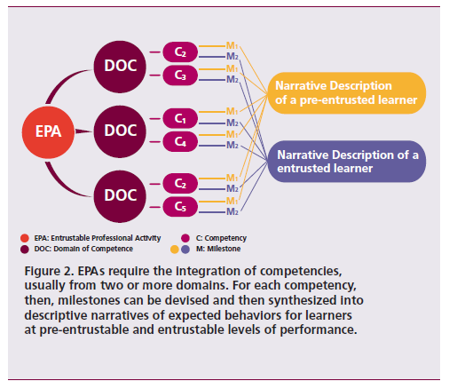

Slide 4
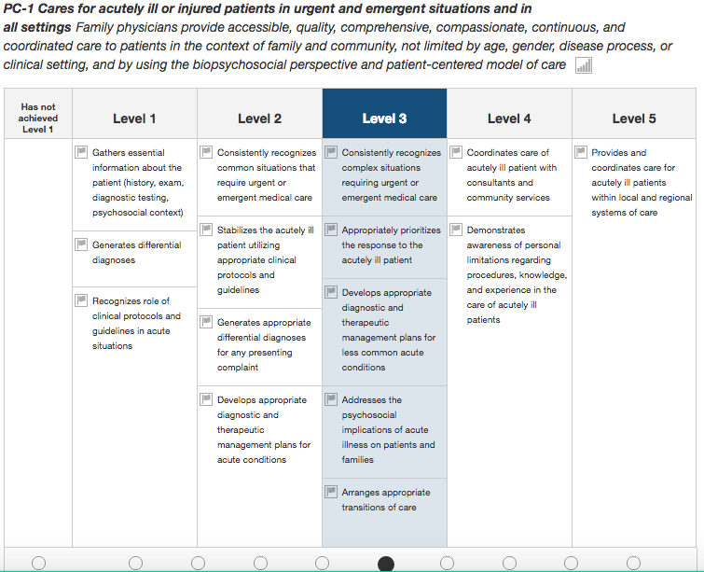
General
Competency
Subcompetency
Developmental progression or set of MILESTONES
Milestone Description
Milestone Level

Slide 5
Methods for using EPAs in Curriculum Design
Program evaluation
EPAs as goal statements for curriculum
Streamlining or augmenting curriculum
Reverse mapping from milestones to EPAs
Defining program priorities.

Slide 6
Program Evaluation – Annual Program Review
Example: EPA 6 – evaluate and manage undifferentiated symptoms and complex conditions.
If residents in their final year of training have not reached entrustment for independence it implies a deficit in competence.
Key subcompetencies mapped to this EPA
PC 4
MK 1, 2
SBP 1
PBL 1
Prof 1,3,4
Comm 1-2

Slide 7
Annual Program Review
Program can choose to focus on
PBL – 1 –Locates, appraises, and assimilates evidence from scientific studies related to the patients’ health problems.
Prof -4 - Maintains emotional, physical, and mental health; and pursues continual personal and professional growth.
The faculty can then develop curriculum to address these particular skills in the context of patients with undifferentiated symptoms.

Slide 8
Program Evaluation – Graduate Survey
Grad surveys currently:
Focus on discrete components of either residency curriculum or current practice.
Have not addressed graduates’ competence in the more broadly defined EPA skills.
EPAs could be used to develop survey questions addressing the ways the residency program prepared the graduate for practice.

Slide 9
Graduate Survey
Example - EPA # 2 – Cares for patients and families in multiple settings
Brief description of the EPAs would show that care across a continuum of settings is a major part of this EPA.
To assess graduates, the faculty member might create one of the following questions:
As a result of your residency training, how comfortable are you caring for patients in more than one setting (office, hospital, nursing home, ER or other)?
Which of the following settings have you provided care for YOUR patients in the last 12 months (Office, hospital, nursing home, ER or other)?

Slide 10
Methods for using EPAs in Curriculum Design
Program evaluation
EPAs as goal statements for curriculum
Streamlining or augmenting curriculum
Reverse mapping from milestones to EPAs
Defining program priorities.

Slide 11
EPAs as Curriculum Goal Statements
EPAs are statements of broad areas of physician skill which function well as goal statements for residency curriculum.
The sub-competencies and milestones mapped to that EPA can then be used as the objectives for that area of curriculum.
Many residencies currently use milestone language in curricular goals and objectives documents but the connection can seem arbitrary.
Using the EPA to sub-competency mapping will add more clarity to that process.

Slide 12
Process Example for Curriculum Creation
EPA title and brief description
Subcompetencies – from the complete EPA Document
Example of curriculum

Slide 13
Step 1
EPA #4 - Provide preventive care that improves wellness, modifies risk factors for illness and injury, and detects illness in early, treatable stages.
Interpretation - Graduates of family medicine residencies will address the goals of this EPA using an evidence-based and patient-centered approach.

Slide 14
Step 2
Competency Domain | Subcompetency | Milestone Level
Patient Care | PC–3: Partners with the patient, family and community to improve health through disease prevention and health promotion | Level 4 (Integrates disease prevention and health promotion seamlessly in the ongoing care of patients.)
Medical Knowledge | MK–2: Applies critical thinking skills in patient care | Level 3 (Recognizes and reconciles knowledge of patient and medicine to act in patient’s best interest.)
Systems-based Practice | SBP–3: Advocates for individual and community health | Level 3 (Identifies specific community characteristics that impact specific patients’ health.)

Slide 15
Practice-based Learning and Improvement | PBLI-1: Locates, appraises, and assimilates evidence from scientific studies related to the patients’ health problems. | Level 2 (Evaluates evidence-based point-of-care resources.)
 | PBLI-3: Improves systems in which the physician provides care. | Level 3 (Uses an organized method, such as a registry, to assess and manage population health.)
Professionalism | PROF– 3: Demonstrates humanism and cultural proficiency. | Level 3 (Incorporates patients’ beliefs, values, and cultural practices in patient care plans.)
Communication | COMM-1: Develops meaningful, therapeutic relationships with patients and families. | Level 3 (Respects patients’ autonomy in their health care decisions and clarifies patients’ goals to provide care consistent with their values.)
 | COMM-2: Communicates effectively with patients, families and the public. | Level 4 (Educates and counsels patients and families in disease management and health promotion skills. Maintains a focus on patient-centeredness and integrates all aspects of patient care to meet patients’ needs.)

Slide 16
Step 3 Preventive Care Curriculum Based on EPA 4
Goal: As a result of participating in this curriculum residents will provide preventive care that improves wellness, modifies risk factors for illness and injury, and detects illness in early, treatable stages
Objectives
Integrate disease prevention and health promotion seamlessly in the ongoing care of patients
Recognize and reconcile knowledge of patient and medicine to act in patient’s best interest
Identify specific community characteristics that impact specific patients’ health.

Slide 17
Step 3 Preventive Care Curriculum Based on EPA 4
Objectives, continued
Evaluate evidence-based point-of-care resources.
Use an organized method, such as a registry, to assess and manage population health.
Incorporate patients’ beliefs, values, and cultural practices in patient care plans.
Respect patients’ autonomy in their health care decisions and clarify patients’ goals to provide care consistent with their values.
Educate and counsel patients and families in disease management and health promotion skills. Maintain a focus on patient-centeredness and integrate all aspects of patient care to meet patients’ needs.

Slide 18
Methods for using EPAs in Curriculum Design
Program evaluation
EPAs as goal statements for curriculum
Streamlining or augmenting curriculum
Reverse mapping from milestones to EPAs
Defining program priorities

Slide 19
Streamlining Curriculum
Use EPAs to identify areas of overlap and gaps in curriculum.
Review where in the curriculum each EPA is explicitly addressed.
Ascertain areas of curriculum overlap requiring coordination.
This could be true for an EPA which is a specific skill but occurs in multiple settings such as EPA 19 - provide leadership within interprofessional health care teams.

Slide 20
Streamlining Curriculum
Example – EPA 19 - Provide leadership within interprofessional health care teams.
Leadership occurs in all situations where family physicians are caring for patients:
office, nursing homes, and multiple hospital floors.
different team members in each setting.
Explore how and where in the curriculum team membership and leadership are taught to residents.
What didactics, workshops and clinical role modeling is used to teach this skill?
Are all of these aligned in regards to knowledge, skills and attitudes?

Slide 21
Methods for using EPAs in Curriculum Design
Program evaluation
EPAs as goal statements for curriculum
Streamlining or augmenting curriculum
Reverse mapping from milestones to EPAs
Defining program priorities

Slide 22
Reverse Mapping of Milestones to EPAs
Reverse mapping is useful when many graduates are not achieving a milestone considered critical for a particular EPA.
Use the EPA to define additional areas of curriculum applying the technique discussed previously.
Example SBP – 4 – coordinates team-based care - this particular milestone is key to EPA 19.
Use the other subcompetencies associated with EPA 19 as objectives for a team-based care curriculum.

Slide 23
These Subcompetencies Would Include
Mobilizes team members and links patients with community resources to achieve health promotion and disease prevention goals.
Fosters adherence to patient care protocols amongst team members that enhance patient safety and prevent medical errors.
Accepts responsibility for the coordination of care, and directs appropriate teams to optimize the health of patients.
Exhibits self-awareness, self-management, social awareness, and relationship management
Actively seeks feedback and provides constructive feedback to others
Sustains collaborative working relationships during complex and challenging situations, including transitions of care
Effectively negotiates and manages conflict among members of the health care team in the best interest of the patient.

Slide 24
Methods for using EPAs in Curriculum Design
Program evaluation
EPAs as goal statements for curriculum
Streamlining or augmenting curriculum
Reverse mapping from milestones to EPAs
Defining program priorities

Slide 25
Defining Program Priorities
Many programs have a particular area in family medicine that is considered a strength or focus of recruitment.
Using the language of EPAs, the mission of the program can be more clearly stated to applicants, residents, faculty and the community.

Slide 26
Defining Program Priorities Example
EPA-15 - Develop trusting relationships and sustained partnerships with patients, families and communities.
All physicians and residencies would strive to achieve this goal.
A residency may wish to use this as an overall statement of core values.
This would then drive decisions regarding curriculum and priority setting.

